Slide 1
RAPORT BASIC dla branży ogrodniczej przygotowany przez InfoCredit we współpracy z MTP – organizatorem największych w Europie Środkowej targów przemysłu ogrodniczego GARDENIA
Basic Report
for the horticultural industry
prepared by InfoCredit in cooperation with PIF - the organizer of GARDENIA, the largest garden fair in Central Europe

Slide 2
Raport branżowy został przygotowany na podstawie najbardziej aktualnych danych dostępnych w dniu 19.02.2018 roku w bazach: firmy InfoCredit, Międzynarodowych Targów Poznańskich oraz United Nations Comtrade Database (DESA/UNSD).
THE INDUSTRY REPORT was prepared on the basis of the most current data available on 19/02/2018
from databases:
InfoCredit Company,
Poznan International Fair,
United Nations Comtrade Database (DESA/UNSD).

Slide 5
1. Analysis of the financial results of exhibitors and the horticultural industry*
*the industry is determined on the basis of the top 5 PKD codes among fair exhibitors

Slide 6
The most important information:
Strong increase in the revenue of exhibitors in 2011-2016,
Companies-exhibitors at PIF belong to the companies with the best profitability in the industry.

Slide 7
Exhibitors' revenues are growing faster than the rest of the industry
Dynamics of exhibitors' revenues vs. companies from the horticultural industry
Increase in exhibitors’ revenues (compared to 2011) Increase in industry revenues (compared to 2011)
Increase in revenues compared to the previous year

Slide 8
Exhibitors are leaders in the industry
Profitability of trade fair exhibitors*
Profitability of the horticultural industry*
Negative profitability Positive profitability
*the term "profitability" answers the question - whether the net profit (after tax) of the company was a positive or negative value

Slide 9
2. Export from Poland vs. Import to Poland of garden plants

Slide 10
The most important information:
The value of Polish garden plant exports in 2016 amounted 206 milion USD (167 milion EUR) , recording solidary increases in the last 2 years by 5% and 16% y / y,
The balance in the trade of garden plants is systematically improving - both by increasing exports and by reduceing imports,
Traditionally, most garden plants are imported from the Netherlands (as much as 70% of the value of imports), and the main export markets are Russia, the Netherlands and Germany.

Slide 12
3. The largest sales markets for Polish exporters

Slide 13
The most important information:
The value of Polish export to the most important markets of garden plants increased in 2016 by: 6% to Russia, 27% to the Netherlands and 14% to Germany,
Export to Belarus doubled in 2016,
The Netherlands is invariably a hegemon in the production and export of garden plants. It has the largest share in imports in the foreign markets in this sector - even at levels exceeding 80% of all imports.

Slide 14
Significant increase in garden plant exports to Belarus

Slide 15
Dutch garden plants are the biggest competition for Polish plants
The largest foreign sales markets for Polish exporters |  | Poland's main competitors in its largest sales markets in 2016 (ranking by shares of the import in a given country)
 |  | 1 | 2 | 3 | 4 | 5 | 6 | 7 | 8 | 9 | 10
1 | Russia | Ecuador | Italy | Netherlands | Kenya | Poland | Columbia | Israel | Germany | Spain | Denmark
2 | Netherlands | Kenya | Germany | Belgium | Ethiopia | Italy | USA | Ecuador | Spain | Denmark | Costa Rica
3 | Germany | Netherlands | Denmark | Italy | Kenya | China | Spain | Poland | Belgium | France | USA
4 | Belarus | Ecuador | Poland | Kenya | Netherlands | Columbia | Italy | Israel | Moldova | Germany | Latvia
5 | Italy | Netherlands | Germany | Spain | France | Belgium | Poland | Thailand | Denmark | Ecuador | Japan
6 | Denmark | Netherlands | Germany | Belgium | Italy | Poland | Sweden | UK | Lithuania | France | Spain
7 | UK | Netherlands | Kenya | Columbia | Belgium | Gramany | Italy | RSA | Ireland | Ethiopia | Denmark
8 | Austria | Netherlands | Germany | Italy | Denmark | Hungary | Poland | Belgium | France | Slovenia | Switzerland
9 | Lithuania | Netherlands | Czech | Poland | Denmark | Belgium | Italy | Latvia | Germany | Austria | Finnland
10 | Latvia | Netherlands | Poland | Germany | Italy | Lithuania | Finnland | Belgium | Denmark | Sweden | Estonia

Slide 16
4. Import of garden plants from a global perspective

Slide 17
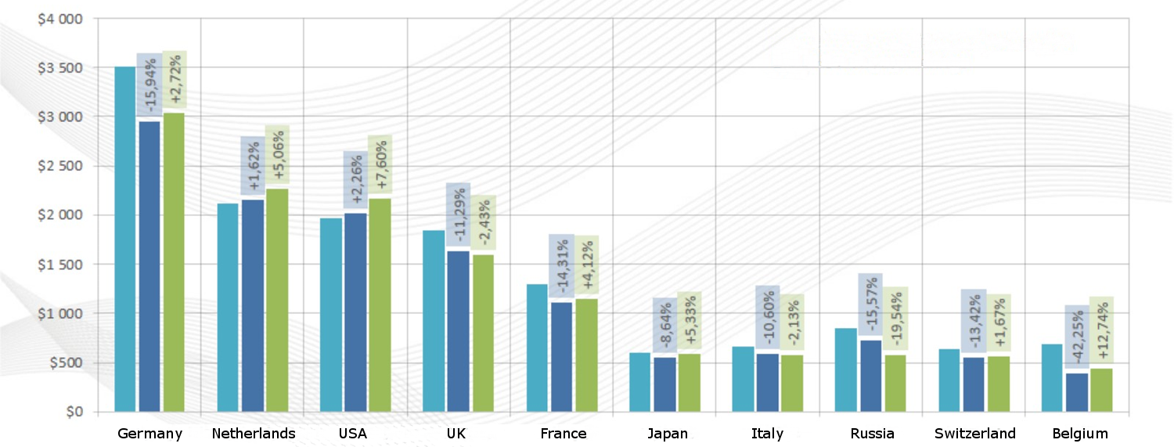
Top 9 largest garden plant importers in the world in 2016
The value of imports in selected countries (USD million) in the years:

Slide 18
5. The most popular export countries among the exhibitors at GARDENIA 2018

Slide 19
Main directions of exports of Polish companies in the industry

Slide 20
6. GARDENIA 2018 fairs statistics

Slide 21
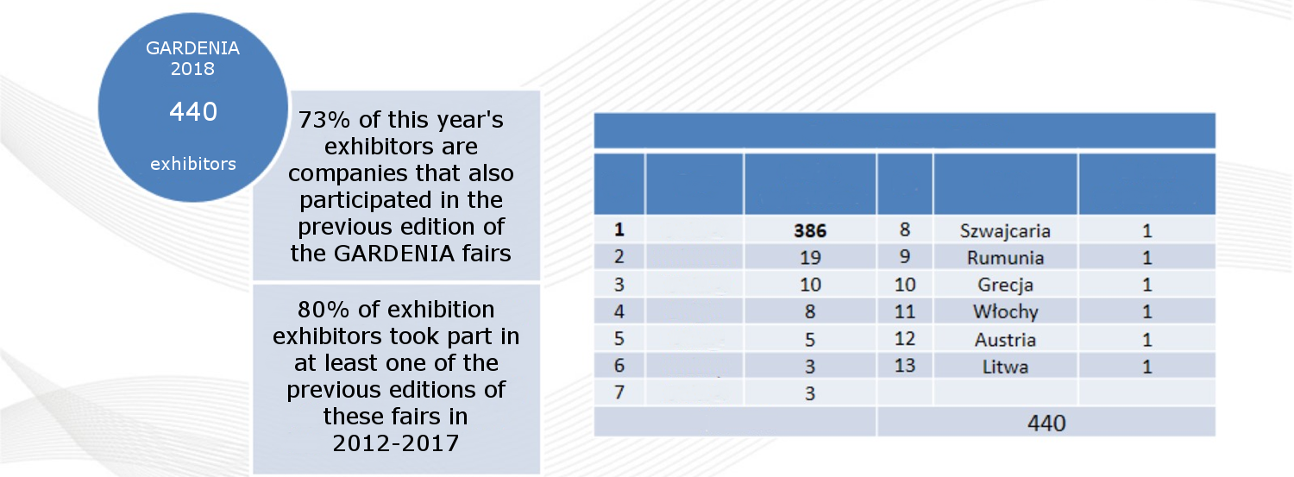
Structure of exhibitors
No | Country | Amount of Exhibitors | No | Country | Amount of Exhibitors
1 | Poland | 386 | 8 | Switzerland | 1
2 | Netherlands | 19 | 9 | Romania | 1
3 | Germany | 10 | 10 | Greece | 1
4 | Belgium | 8 | 11 | Italy | 1
5 | China | 5 | 12 | Austria | 1
6 | Czech | 3 | 13 | Lithuania | 1
7 | France | 3
Total: |  |  | 440

Slide 23
PREMIUM Report version is available to purchase from the publisher InfoCredit
Contatct:
+48 22 827 54 86
www.infocredit.pl
bok@infocredit.pl
ul. Foksal 10, 00-366 Warszawa

