Slide 1
Evolution of the construction sector in Romania Corneliu Fecioru – Managing Director, Wienerberger

Slide 2
CONTENT
Romania Macroeconomics
The overall market – the big picture
Office market
Retail commercial developments
Industrial market
Land market
Residential developments
Some conclusions & comments

Slide 3
1. Romania Macroeconomics
Based on increased consumer confidence and domestic consumption
Increased minimum wage
Reduction of VAT from 24% to 20%
Increased RON-denominated lending (+44% YoY)
RON denominated mortgages doubled in 2015

Slide 4
2. The overall market – the big picture
2015: +10,4% overall vs. 2014 (all data, gross series, monetary value)
Structure of industry
New buildings +5%
Capital repairs +32%
Usual maintenance +13%
Structure by objects
Engineering works +20% (includes roads, railways, bridges, airports, stadiums etc.)
Non-residential works +1% (include offices, shops, warehouses etc.)
Residential works - 6% (spaces for residential use of min. 50% surface)
Source: INSSE – the Romanian Statistics Institute

Slide 5
3. Office market
Bucharest main office market in RO with more than 360,000 sqm to be delivered in 2016, some 800,000 sqm until 2018
The bulk of projects goes to Floreasca-Barbu Vacarescu, Center West and Dimitrie Pompeiu
Outsourcing expected to generate most of the demand in the coming years
Sources: Colliers 2015 Report, JLL analysis

Slide 6
4. Retail commercial developments
Encouraged by household consumption (+5,7% vs. 2014): food +16%, non-food +1%
Most retailers expanded their presence in 2015
New international brands entered RO in 2015
Forecast to increase with additional 500,000 sqm by 2020
Source: Colliers 2015 Report , JLL analysis

Slide 7
5. Industrial market
Some 900,000 sqm GLA announced for 2016-2017
Sources: Colliers 2015 Report , JLL analysis

Slide 8
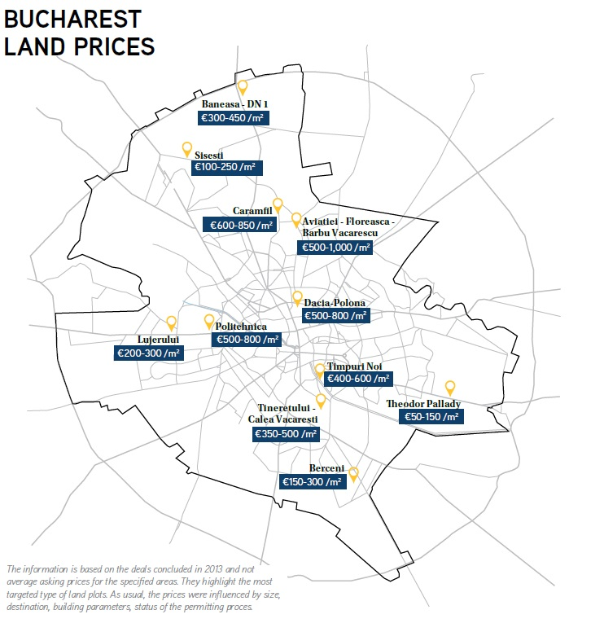
6. Land market
Source: Colliers 2015 Report

Slide 9
7. Residential developments (1)
Source: INSSE – the Romanian Statistics Institute, Wienerberger analysis

Slide 10
7. Residential developments (2)
Source: INSSE – the Romanian Statistics Institute, Wienerberger analysis

Slide 11
7. Residential developments (3)
Source: INSSE – the Romanian Statistics Institute, Wienerberger analysis

Slide 12
7. Residential developments (4)
Source: INSSE – the Romanian Statistics Institute, Wienerberger analysis

Slide 13
8. Some conclusions & comments
Fiscal aspects
VAT at 20% (from 24%) in 2016, to be reduced to 19% after 01.01.2017
5% VAT for social housing (up to 450 TRON with 01’16, vs. 380 TRON till 12’15)
Residential financing
More RON denominated loans
New law: “legea darii in plata”
Overview mortgage credits
Acc. to BNR there are some 474,000 mortgage credits in RO (worth 17,2 bn. €), out of which some 17,500 credits are non performing loans (delays > 90 days)
Prima Casa covers some 180,000 credits (worth 6,7 bn. €)
The new law applies to 99,5% from standard credits (293,000 contracts)

Slide 14
Annex: First House - summary
Launched in 07’2009
Prima Casa covers some 180,000 credits (worth 6,7 bn. €)
Open to first time house buyers or owners of dwellings < 50 sqm
Buying an existing dwelling worth up to 57 T€
For dwelling with permits issued after 22.02.2010:
New dwelling worth up to 66,5 T€
For building a SFH
New house worth up to 70 T€
Duration of credit – from 120 to 360 months

