Slide 1
Business environment and EU funds 2014-2020 in Romania
Johannes Becker
Bucharest, 7.5.2018

Slide 2
News of last Friday

Slide 3
Plus and Minus
PROS | CONS
Flat tax (still) Growing home market Low salaries (still) Increasing consumption Foreign languages Agriculture ITC EU-Funds | Lack of workforce – depending on region Unsustainable growth Intransparency Instability Bureaucracy Infrastructure Low productivity EU-Funds

Slide 4
Population

Slide 5
Plus and Minus
PROS | CONS
Flat tax (still) Growing home market Low salaries (still) Increasing consumption Foreign languages Agriculture ITC EU-Funds | Lack of workforce – depending on region Unsustainable growth Intransparency Instability Bureaucracy Infrastructure Low productivity EU-Funds

Slide 6
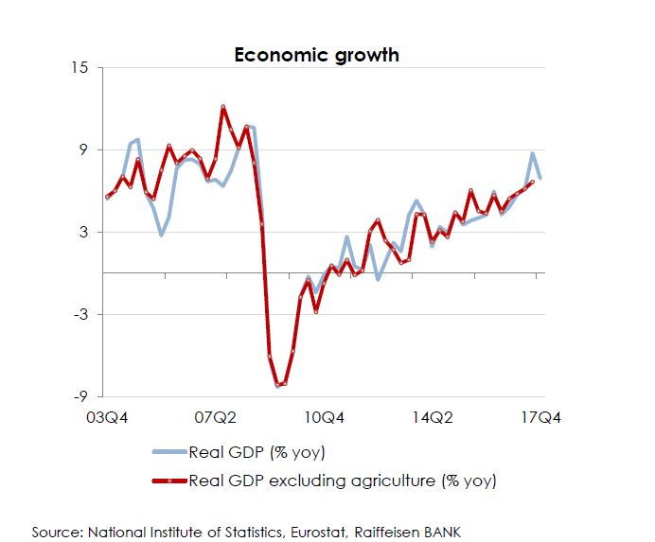
GDP Development

Slide 7
Plus and Minus
PROS | CONS
Flat tax (still) Growing home market Low salaries (still) Increasing consumption Foreign languages Agriculture ITC EU-Funds | Lack of workforce – depending on region Unsustainable growth Intransparency Instability Bureaucracy Infrastructure Low productivity EU-Funds

Slide 8
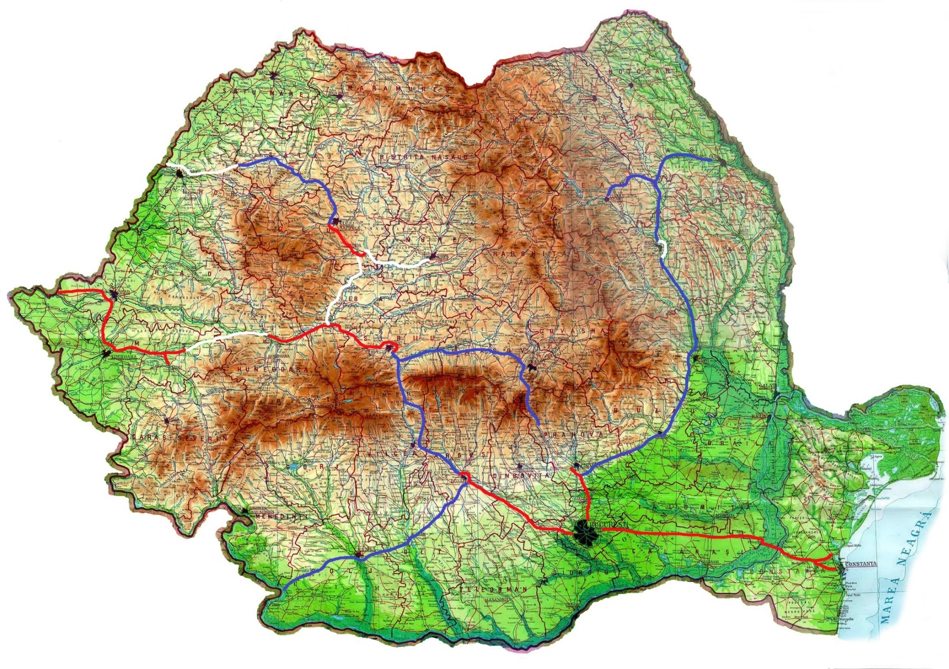
Finalized
Construction
Iasi
Project
Oradea
Targu Neamt
Cluj
Targu Mures
Bacau
Arad
Deva
Sibiu
Brasov
Focsani
Timisoara
Ploiesti
Buzau
Pitesti
Craiova
Constanta
Bucharest

Slide 9
Plus and Minus
PROS | CONS
Flat tax (still) Growing home market Low salaries (still) Increasing consumption Foreign languages Agriculture ITC EU-Funds | Lack of workforce – depending on region Unsustainable growth Intransparency Instability Bureaucracy Infrastructure Low productivity EU-Funds

Slide 10
Having a Romanian Subsidiary
Limited Liability Company (SRL): minimum capital is RON 200 (approx. EUR 50)
Taxes:
Companies registering a turnover above Euro 1 million: corporate income tax rate of 16%
Micro Enterprises: Revenues lower than 1 million Euro, no taxation of profits, instead tax on revenues:
1% for companies with employees
3% for companies without employees
No possibility to carry forward losses of previous years
Micro enterprises can voluntarily switch to corporate income tax if they have a subscribed share capital of at least RON 45,000 and at least two employees
Dividends: 5% income tax
PL
CZ
SK
AT
HU
SL
RO
HR
RS
BG
AL

Slide 11
Having a Romanian Subsidiary
VAT: general 19%, on food and some other products 9%
Social contributions on employment income:
Contributions deducted from the gross salary:
25% – Pension insurance contribution
10% – Health insurance contribution
Additional pension insurance contribution: 4% or 8% borne by employers for particular / special working conditions
Work insurance contribution: 2.25% of gross salary – borne by employers
Personal income tax rate as from 1 January 2018: 10%
PL
CZ
SK
AT
HU
SL
RO
HR
RS
BG
AL

Slide 12
Taxes Overview

Slide 13
EU-Funds

Slide 14
2014 - 2020
About 30.7 bn Euro EU-funds for 2014 – 2020;
Approximately 150 subprograms within 8 operational programs;
90% of the funds are destined for public projects, only 10% are directly accessible for private companies;
Romania has the worst results in using EU-funds
In the period 2007-2013 Romania could use only about 80% of the available funds
Now almost two thirds of the period 2014-2020 have passed, and only about 6% of the EU-funds have been absorbed
Romania stopped financing its State Aid Programs for investors in 2017

Slide 15
What the EU-Funds are being used for
Operational Program | Budget | Management Authority
Large Infrastructure Projects | 9,41 bn Euro | Ministry for EU-Funds
Rural Development | 8,01 bn Euro | Ministry for Agriculture
Regional Development | 6,70 bn Euro | Ministry for Regional Development
Human Capital | 4,33 bn Euro | Ministry for EU-Funds
Competition | 1,33 bn Euro | Ministry for EU-Funds
Technical Assistance | 0,55 bn Euro | Ministry for EU-Funds
Administrative Capacity | 0,21 bn Euro | Ministry for Regional Development
Fishery | 0,17 bn Euro | Ministry for Agriculture

Slide 16
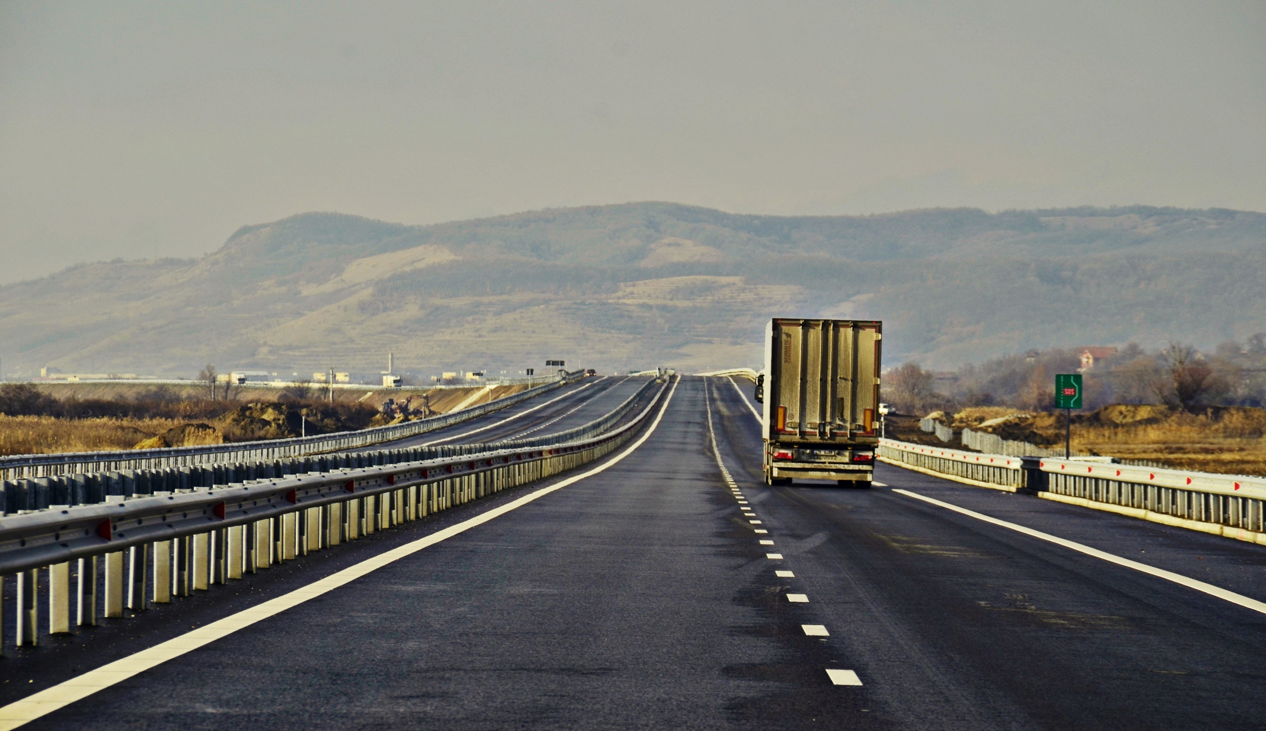
Road Infrastructure

Slide 17
Road Infrastructure
EU-Funds from three different programs;
3,272 mil. Euro for highways and national roads, of which 1,920 mil. Euro for TEN-T highways;
Construction of by-passes;
Improve capacity of main traffic routes;
Construction or modernisation of secondary and tertiary county- and local roads;
Many announcements for projects, not yet clear which ones will receive EU-funds;

Slide 18
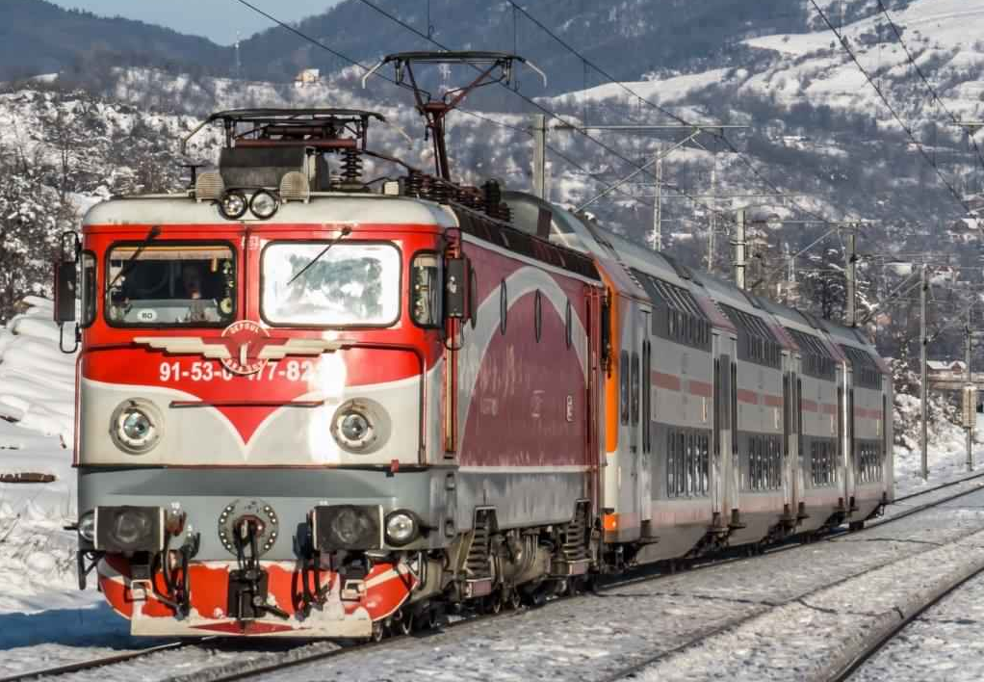
Railroad Infrastructure

Slide 19
Railroad infrastructure
1,4 bn. Euro for TEN-T;
447 mil. Euro for increasing sustainability and quality of railroad transport;
Modernizing the TEN-T 22 segment Nadlac-Constanța for speeds of 120/160 km/h;
Organisational reform of the railroad system;
Improvements and modernization of stations;
Elimination of degenerated track portions causing speed restrictions;
Security infrastructure;
Purchase of new rolling stock, capable of ERTMS;

Slide 20
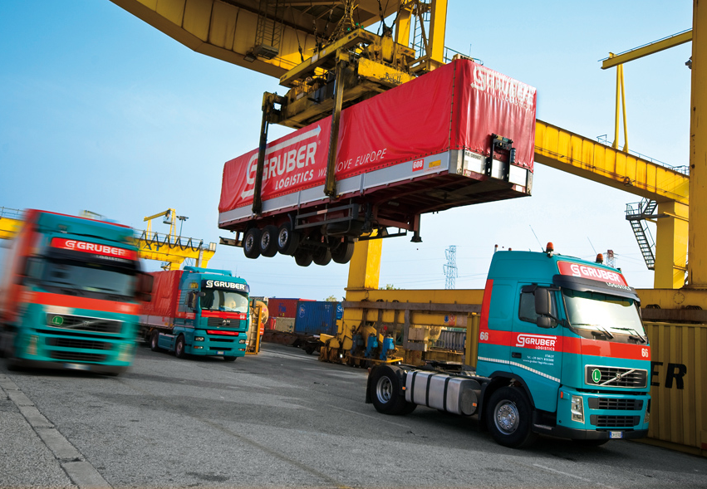
Ports and terminals

Slide 21
Ports and terminals
256 mil. Euro EU-funds for Danube ports;
95 mil. Euro for multimodal terminals;
Investments in infrastructure of the Danube ports, including road and railroad connections, dikes and piers;
Deepening of the waterways in Danube ports;
Improvements of Danube navigation;
Modernizing of watergates;
Modernizing and developing multimodal terminals, their installations and equipment;

Slide 22
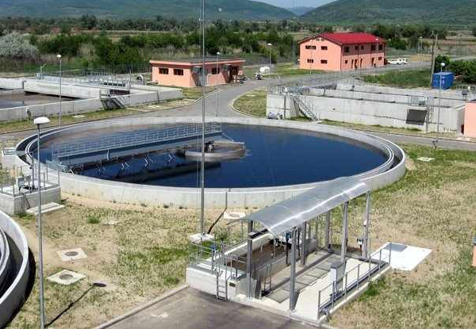
Environmental Projects

Slide 23
EU-Funds for Environment - Water
More than 40% of Romanian population not yet connected to drinking water and/or sewage systems
Romania is under huge pressure to fulfill EU-standards
Counties and towns: 2,570 mil. Euro for large projects
Rural areas – up to 2.5 mil. Euro for new networks, up to 1.5 mil. Euro for extensions
Tendering authority is in most cases a regional water association (ADI) or the local community
New drinking water networks are only approved when connected to a sewage system

Slide 24
EU-Funds for Environment – Waste Collection
Collection of waste materials, depoziting, waste separation and treatment, recycling, new landfills, closing of old landfills
318 mil. Euro EU-funds can be spent by cities and counties
Tendering authority is in most cases a city council or the local community
Currently no EU-funds for incineration projects planned
Recycling can be an eligible acticity for provate companies

Slide 25
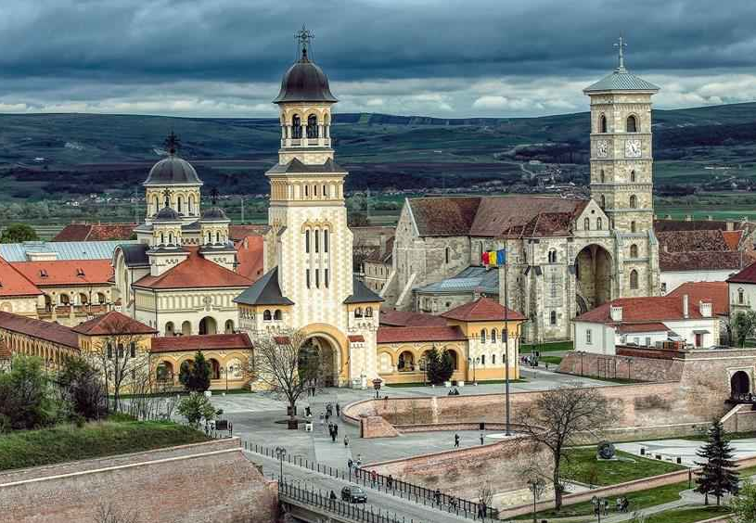
Urban Development Projects

Slide 26
EU-Funds for Urban Development
Urban mobility
Energy Efficiency for public buildings (hospitals, schools, administrative buildings, prisons) – 830 mil. Euro EU-funds for heat insulation, new heating systems, energy saving, etc.
Three new regional hospitals will be constructed (Cluj, Iasi, Craiova)
EU-funds for restoring cultural monuments and city-centers
Funds for renovating and modernizing schools
Co-generation, geothermal and biomass power plants – applications can be submitted by city halls, companies and industrial parks
District heating – 249 mil. Euro for modernisation of plants and networks

Slide 27
EU-Funds for Companies

Slide 28
Investment support for SMEs (Small and Medium Enterprises)
1,045 million euro budget
Investments by manufacturing and service companies – but only selected branches
Eligible costs are construction, expansion and modernization of buildings, production equipment, IT
SMEs in cities could receive funding of up to 1 million Euro
Micro-Enterprises and small businesses in rural areas up to 200,000 Euro
Up to 70% funding, for micro-enterprises up to 90%
These funds have been used up in 2017 – not yet sure whether it will be possible to submit applications again

Slide 29
Agriculture and Food Industry
The programs that cause the least difficulties
Preferably small and medium-sized farms
50% - 90% support
Support for farms:
Machines and equipment without construction - up to 500,000 Euro
Machines and buildings - up to 1-1.5 million Euro
Up to 2 million Euro funds for complete production chain
Support for Food Industry:
Up to 1 million Euro, up to 50% of eligible costs

Slide 30
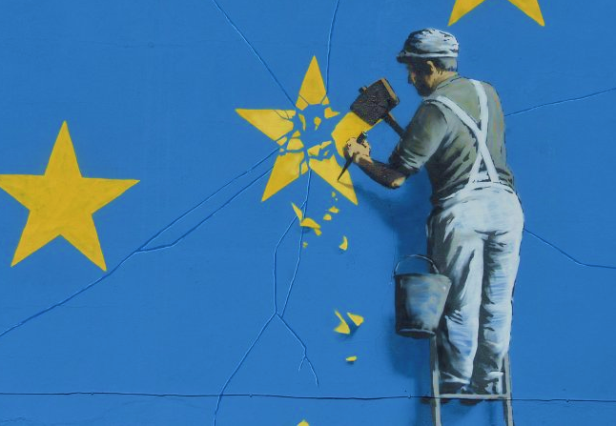
EU-Funds
Why Romania fails

Slide 31
Problems
Frequent changes of officials and strategies slow down progress;
Much too restictive eligibility criteria, much too complicated procedures;
Software (MySMIS);
Preparation of projects often starts too late;
Long evaluation periods;
Many projects fail in the phase of public acquisition - endless appeals delay decisions and start of construction;
Lack of communication from authorities;
Long terms for payments due to insufficient budgetary funds to implement the projects smoothly;

Slide 32
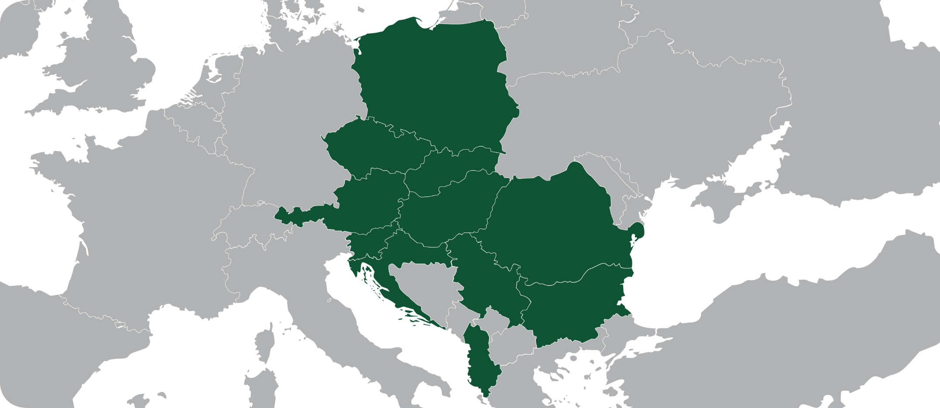
The TPA Group. A One-Stop Shop.
The TPA Group offers cross-border consultancy on an equal footing with the client, and with a broad range of products, nationally and internationally:From Accounting, Payroll, Tax Advisory and Audit to Business Consultancy.
PL
CZ
SK
AT
HU
Sl
RO
HR
RS
BG
AL

Slide 33
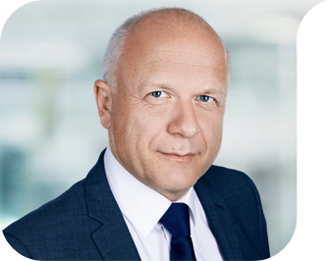
Johannes Becker
Business Consultant | Partner
Tel.: +40 21 3100669
johannes.becker@tpa-group.ro
www.tpa-group.ro
www.tpa-group.com
PL
CZ
SK
AT
HU
Member of the Coalition for the Development of Romania
Member of National Association of Consulting Companies
Services and Areas of Expertise:
Business Consulting
EU-Funds
National Funds
Strategic Development
Textiles
Automotive
Agriculture & Forestry, Wine
Alternative Energy
Pharma
Waste Industry
Construction Materials
Social Projects, NGOs
Public Administration
Media
RO
SI
HR
RS
BG
AL

