Slide 1



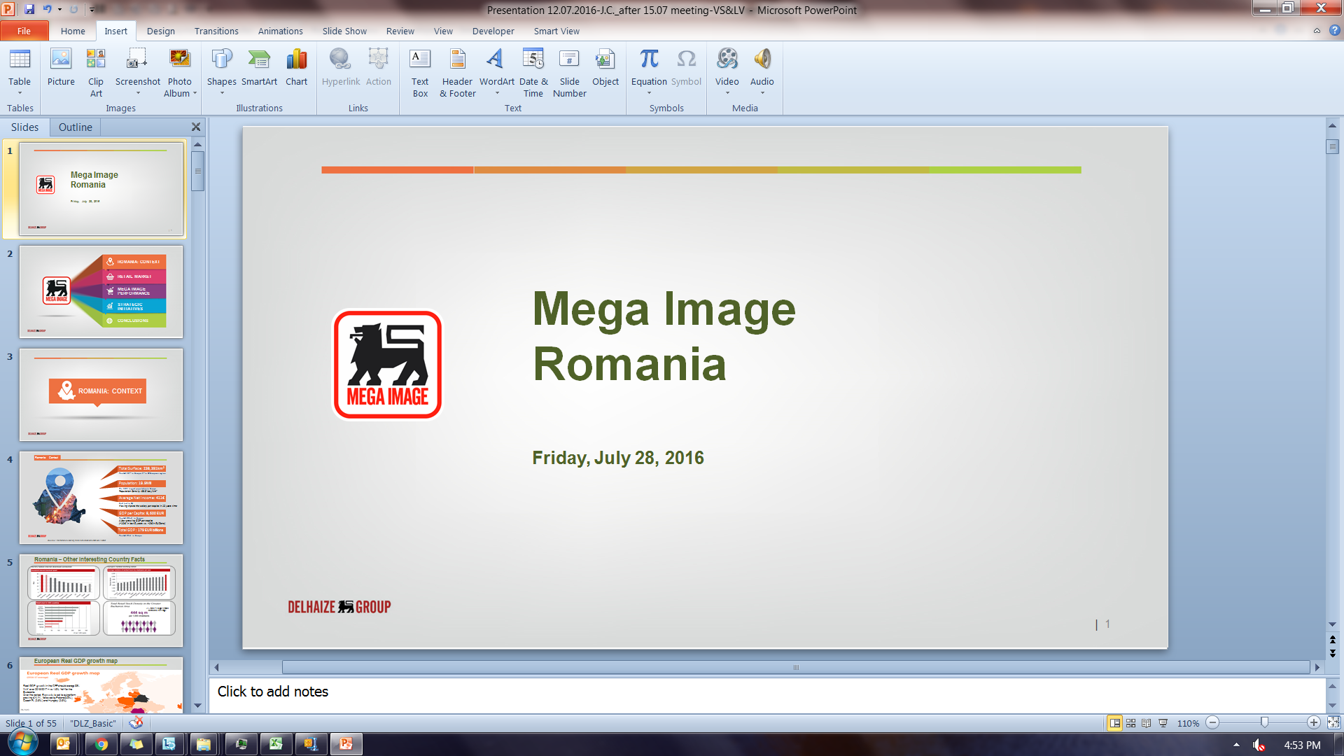
Mega Image
Romania
| 1

Slide 2


ROMANIA: CONTEXT
RETAIL MARKET
MEGA IMAGE PERFORMANCE
STRATEGIC INITIATIVES
CONCLUSIONS
| 2

Slide 3

ROMANIA: CONTEXT

Slide 4

Romania: Context
Total Surface: 238,391km²
Ranked 13th in Europe, 1st in SE European region
Population: 19.9Mil
The 10th largest population in Europe
Population Density: 93.5 loc./km²
Average Net Income: 411€
2nd last in EU
Having tripled the salary per capita in 10 years time
GDP per Capita: 8,600 EUR
Ranked 32nd in Europe
A fast growing GDP per capita
(+10% in last 5 years vs. +2% in EU Zone)
Total GDP : 179 EUR billions
Ranked 21st in Europe
Source: International Monetary Fund World Economic Outlook/ INSSE

Slide 5
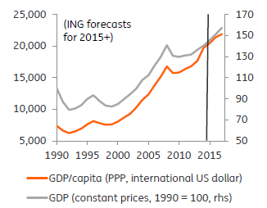
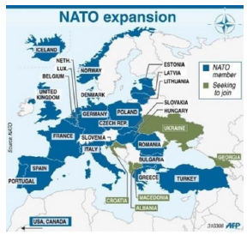
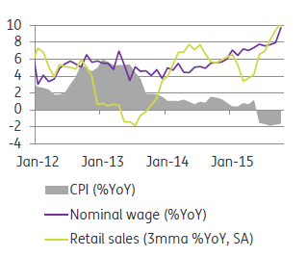
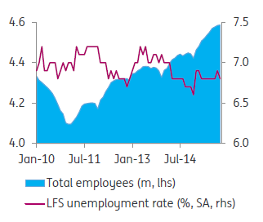
Romania, the long transition journey…
After a lost decade, the Romanian
economy accelerated
Romania –
a crucial partner
for the West in current turbulent geopolitics
Unemployment Rate
is decreasing
Solid wage
growth &
negative CPI
-5.8%
Jan’16 vs Jan’15
Close to 0% unemployment rate in Bucharest
*LFS - Labour Force Survey
*rhs – right hand side
lfs – left hand side
SA – Seasonal adjustment

Slide 6
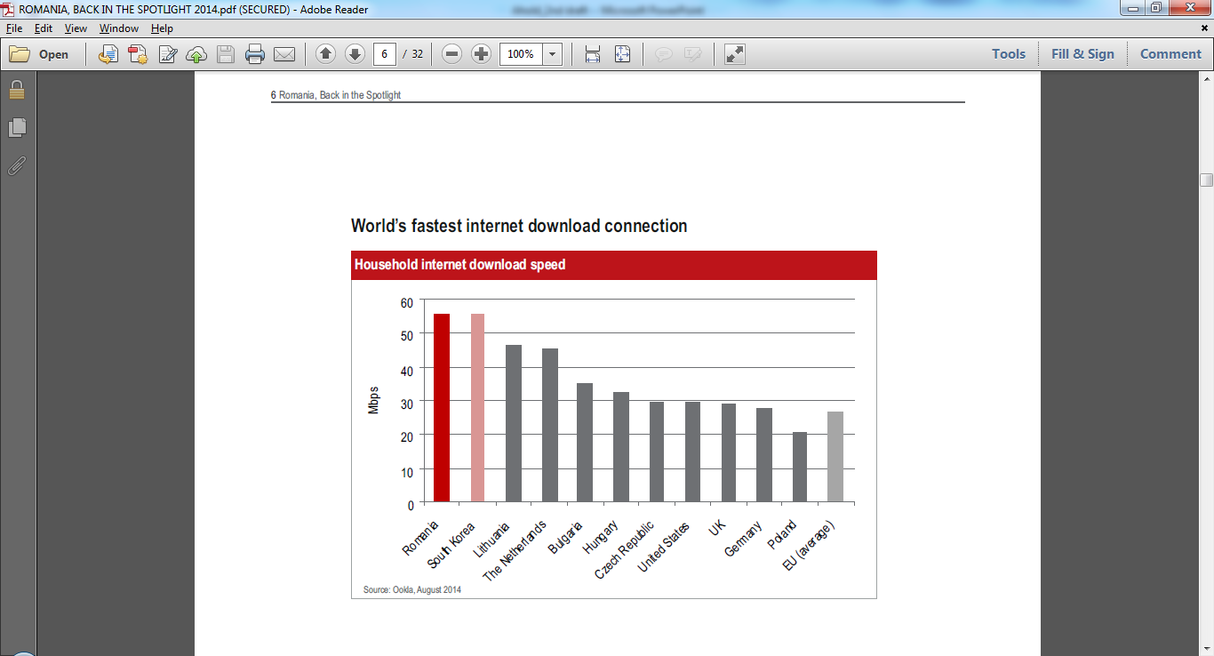
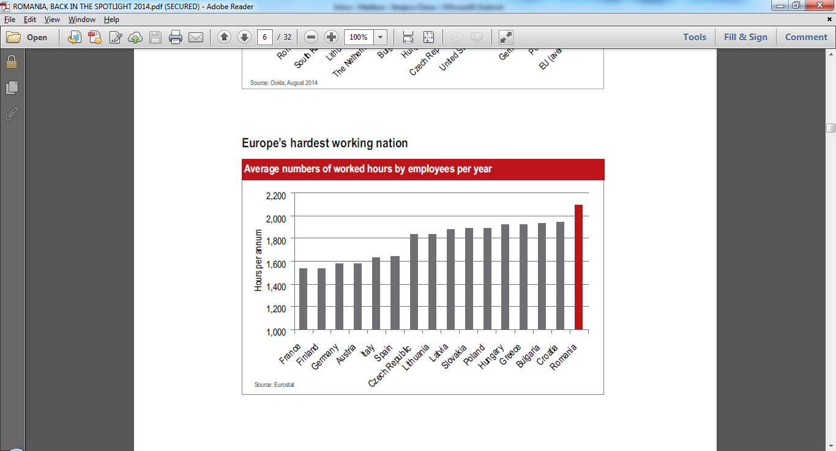
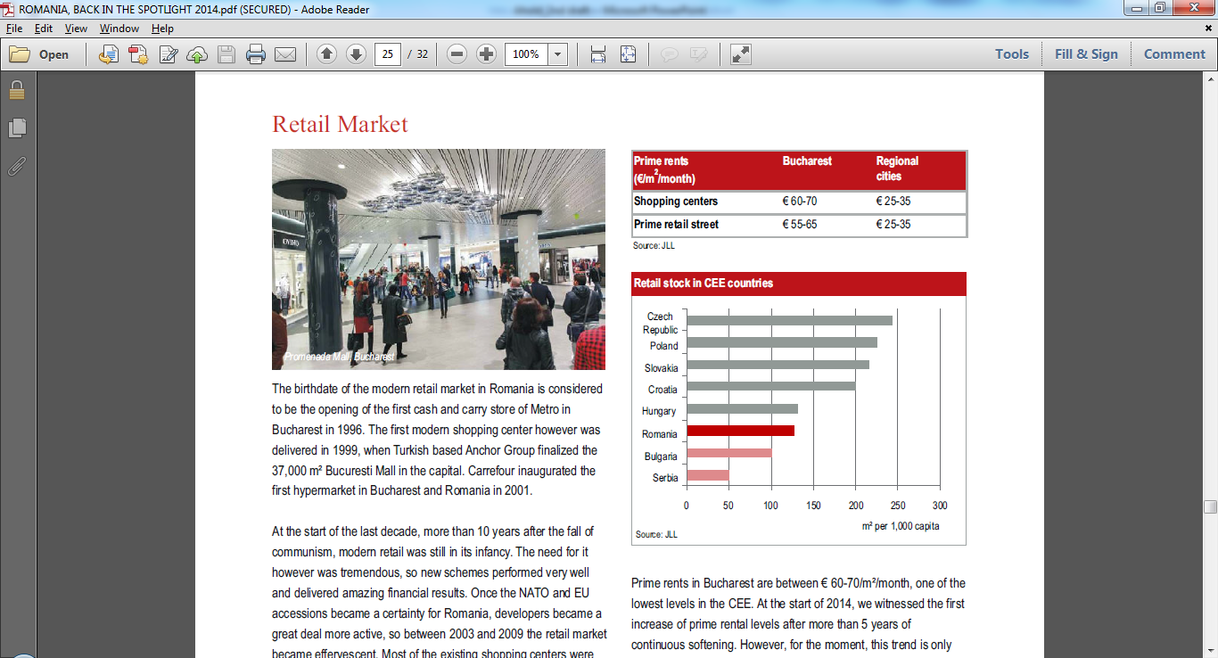
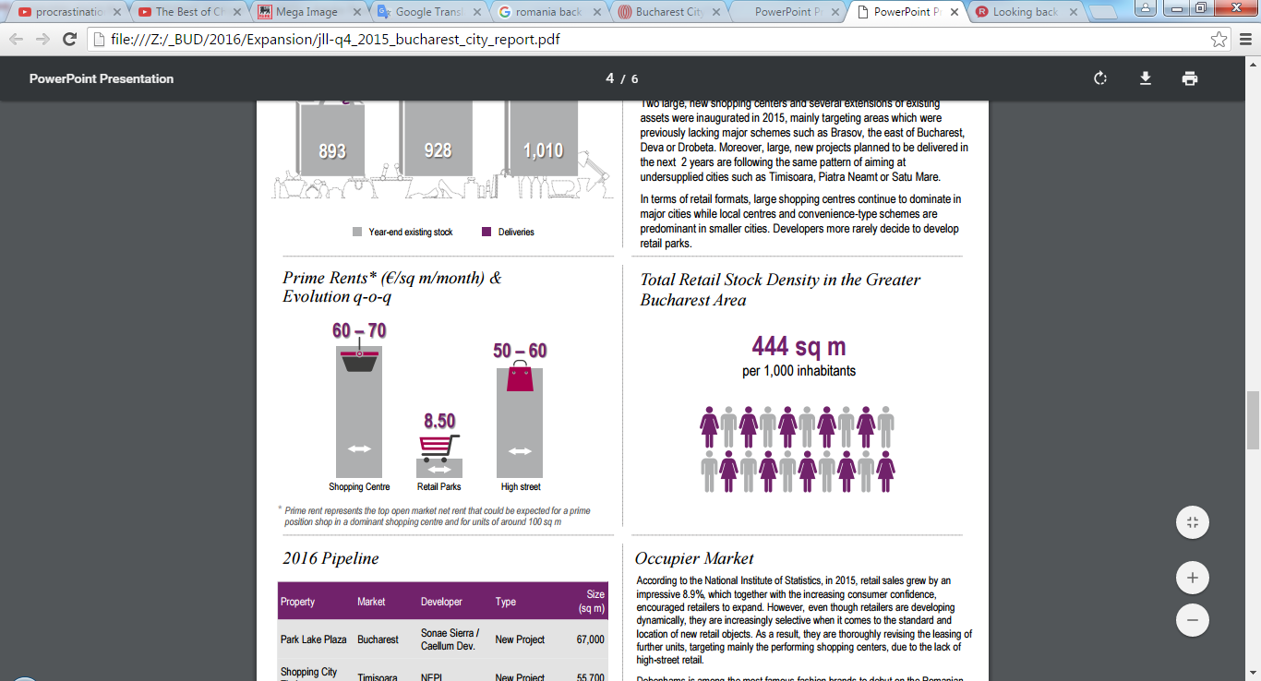
Romania – Other Interesting Country Facts
3.5 times higher than national average

Slide 7
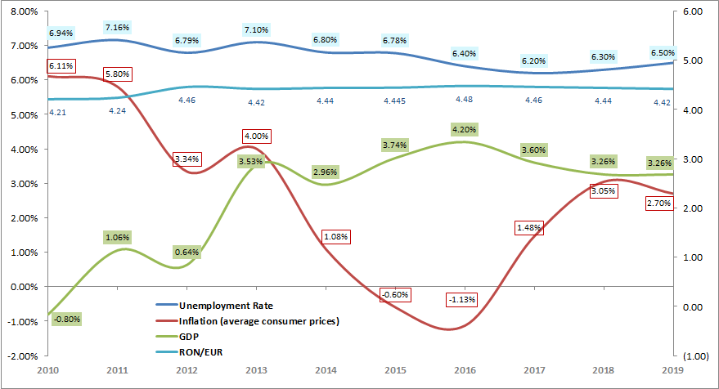
Macro economics Evolution
Economic growth in Romania is among the highest in the EU and with high potential for the coming years.
Inflation includes impact of VAT decrease
Sources: National Bank of Romania, The National Prognosis Commission, ING Bank Forecast

Slide 8
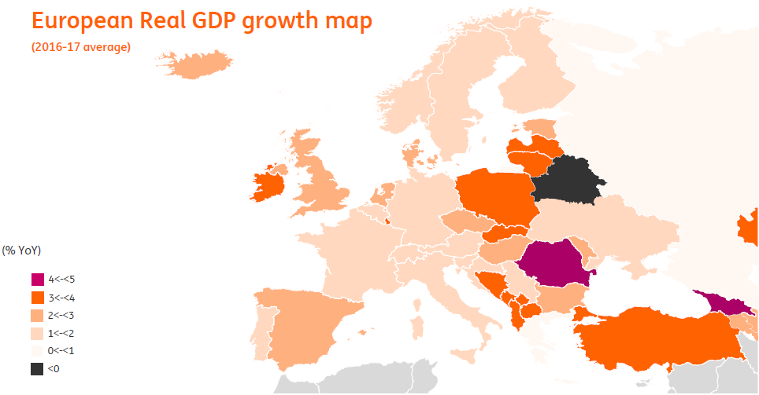
European Real GDP growth map
Real GDP growth in the CEE should average 3.3% YoY over 2016-2017 – vs 1.6% YoY for the Eurozone.
Over the period, Romania is set to outperform, growing c.4.1%, followed by Poland (3.6%),
Czech R. (2.6%) and Hungary (2.6%).
Romania’s Growth Forecast: 4.1% - highest GDP increase in CEE
Source: ING

Slide 9
Romania Landscape
BUCHAREST
10 BIG CITIES
REST OF THE COUNTRY
% GDP: 24.4%
Population: 2.1mil (10%)
% GDP: 31.0%
Density: 8518 inhab./sq km
Market size: 2.5 b€
Competition: 148 stores
Net Income 568€/month
Population: 2.9mil (15%)
Density: 2317 inhab./sq km
Net Income 375€/month
Market size: 2.9 b€
Competition: 316 stores
Competition: 781 stores
Market size: 11.6 b€
Income 332 €/month
Density: N/A
Population: 14.9mil (75%)
% GDP: 44.6%
Sources: Romania-Insider.com, Economica.net, INSSE

Slide 10
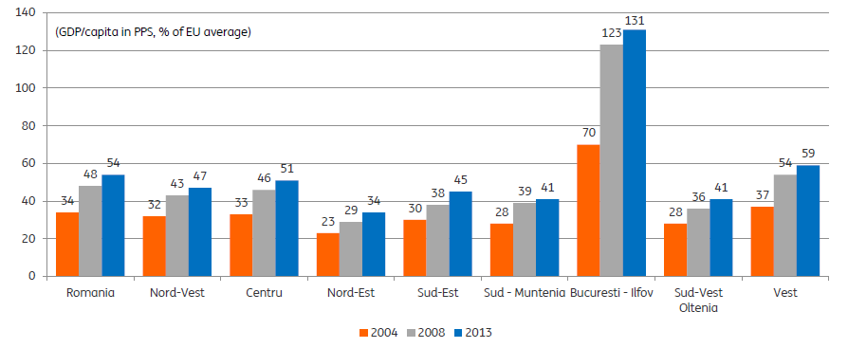
The capital has the highest GDP (in abs. value and per capita)
Current GDP per capita by region
(€B, Romania)
Nord-Vest
Laşi
Oradea
Cluj-Napoca
Nord-Est
Arad
Bacău
Centru
Vest
Sibiu
Braşov
Timişoara
Galaţi
Brăila
The Bucharest-Ilfov region continued to be the fastest growing after 2008 (despite an already high level of GDP/capita versus EU average), expanding by 1.6ppt/year versus a 1.2ppt/year national average
Sud-Muntenia
Sud-Est
Tulcea
Sud-Vest Oltenia
Ploieşti
Piteşti
Bucharest
Constanţa
Craiova
Giurgiu
Bucureşti
– Ilfov
Key
Country average: €8.6K (RON 38K)
Above €8K
From €4K to €6K
From €6K to €8K
Below €4K
Source: National Institute of Statistics INSSE
| 10

Slide 11

Customer Profile
Poza client
| 11

Slide 12
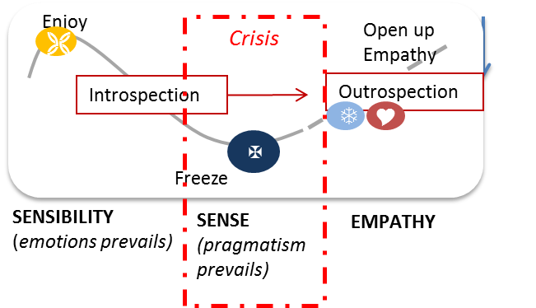
A new consumer era: the era of Empathy (when companies mingle with people)
Last years society evolution have lead to important changes in the way people relate to life.
Is equally about the economical crisis that forced people to re-evaluate usage of resources and about technology outburst (internet) which gave access to unlimited amount of information an any subject
People have a lot of choices. Still, today they are expecting products and brands with more meanings. They look for solutions with whom to connect with in an authentic way and that can enrich their life
TAKE-OUT: a shift from a inward functional approach (what I have to offer) to a more outward approach of listening & covering actual needs of consumers (what people need and what can I offer)
Source: Brand image & customer profile study, Unlock Research 2015
| 12

Slide 13







People no longer wait for help from outside, change is personal
LESS IS MORE (so treasure what you have)
No more resource waste no matter is money, time or emotions
“Time is most important resource. Lost time can never be regained, learn to enjoy every second” (M, 46)
BE > HAVE
Accumulate experiences, remind one of what is essential in life - who you are not just what you have
“Success is not the key to happiness but the reverse is valid. Do what you like and you will have success” (F, 42)
Changes across Romanians
DO / TRY > STAND BY/ RESIGN
Reclaim control over own life. Take initiative instead of expecting to do things
“Is better to fail doing something than be the best in doing nothing.” (M, 54)
Source: Brand image & customer profile study, Unlock Research 2015
| 13

Slide 14






People’s need toward authenticity & real value is also relevant in shopping
Shopping is beyond functional, it is about EMOTIONAL
SEROTONIN – a way to access aspirational goods and restart
your mood/regain energy
The modern hobby of the masses, as the most accessible treat one can get
  Shopping is not so much about status anymore. A full basket does not necessarily mean better life/more valuable individual.
Some trends in shopping
People return to value of things & start to reconsider their choices before investing
  “Selective impulsivity” – people continue to satisfy their curiosity but are much more selective. Products must really benefit them
  Increased shopping frequency, smaller quantities which gives them the feeling of healthier diet/life
| 14
Source: Brand image & customer profile study, Unlock Research 2015

Slide 15

RETAIL MARKET
| 15

Slide 16
Romania – Market and competitive landscape
13_89 20_89
Romania’s Modern retail market: a multinational environment
Romania’s Modern grocery market is very centralized around Bucharest and big cities
Fragmented food industry
  Hypermarket is the main format (~46% of modern retail) but is growing slower than other main formats
  Convenience stores have grown and expected to grow the fastest, followed by supermarkets
  The share of food in total expenditure will remain high for several more years (50%)
MARKET ATTRACTIVENESS
COMPETITIVE LANDSCAPE
Food distribution channels have been continuously expanding
Top players reach more than 50% Market share
Mega Image has been one of the fastest growing players in the market (+35% sales growth over 2010-2015),
Across formats, Mega Image is #1 in Supermarkets and #1 in Convenience stores with Shop & Go

Slide 17
The modern retail market is growing
Grocery retail market - Modern vs. traditional¹
(RONB. 2010-19e, Romania)
Market size in €: ~€20.0B (2015)
2
Source: Planet Retail
| 17

Slide 18

Market Leader in Supermarkets and
Convenience Stores, with an overall RMS of 0.3
Sales per channel and per banner – Modern grocery retail
Market¹ (RONB, 2016, Romania)
Mega Image total sales as per Planet Retail restated based on internal split Mega Image (SM) / Shop&Go (CS)
Carrefour includes Billa , after acquisition - signing Dec. ‘15
AD national RMS
= 0.3
Source: Planet Retail

Slide 19
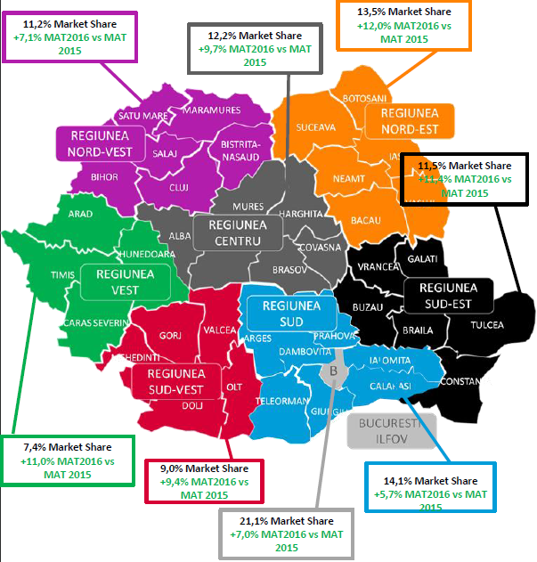
Retail Evolution by Region
Bucharest area has the highest Market Share in Romania: 21.1%
Increase Market Share trend in the areas with potential (Cluj, Timisoara)
Regions Value Market Share in Total Romania.
w/o Discounters and Kaufland
| 19
Source: Nielsen

Slide 20
Top players – Operating model / formats
| 20

Slide 21
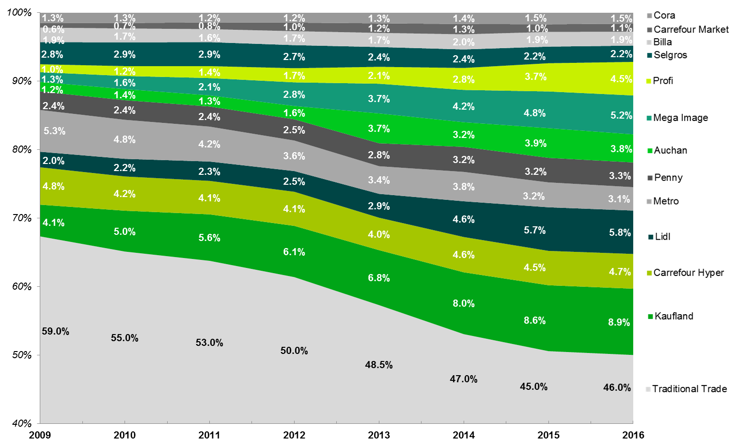
Top players evolution (Food Market)
Market share 2009-2016 (Based on consolidated financial statements)
Total Food grocery market 2016: 19 billion €
Source: Internal computation
| 21

Slide 22
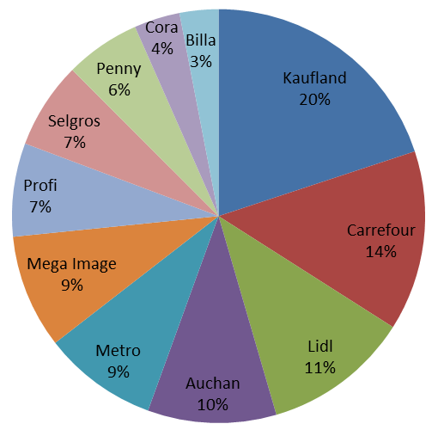
Competition Analysis – Turnover distribution
Turnover includes: Sales, Vendor Allowance & Other Operating Income
Source: public financial data
| 22

Slide 23

MEGA IMAGE PERFORMANCE
| 23

Slide 24
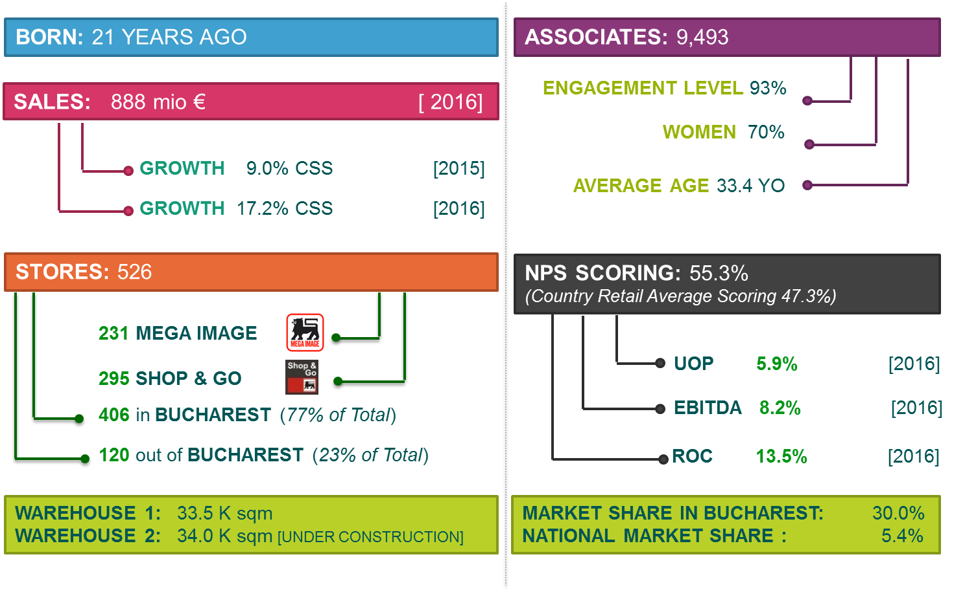
Mega Image – Identity Card
ROUMANIE ROMANIA

Slide 25









Mega Image Story
Acquisition of Angst (19 stores);
410 STores
Delhaize Group finalizes MI acquisition
1st WH opening
Acquisition of 4 PRODAS STORES
Shop & Go launch (253 SG stores 2015 YE)
Acquisition of 14 La Fourmi stores
(reaching 40 stores)
Delhaize Group acquires 51% of MI shares;
10 Stores
1st store opening

Slide 26
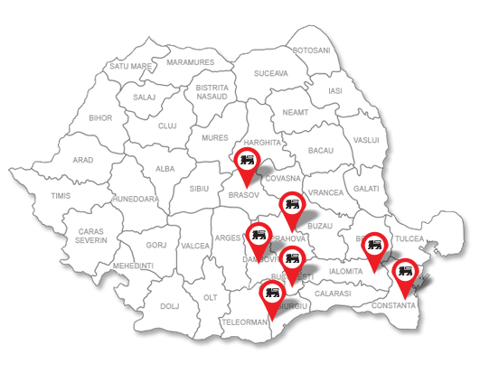
Mega Image presence in Romania
526 Stores
in Romania
| 26
Notes:
#stores updated

Slide 27
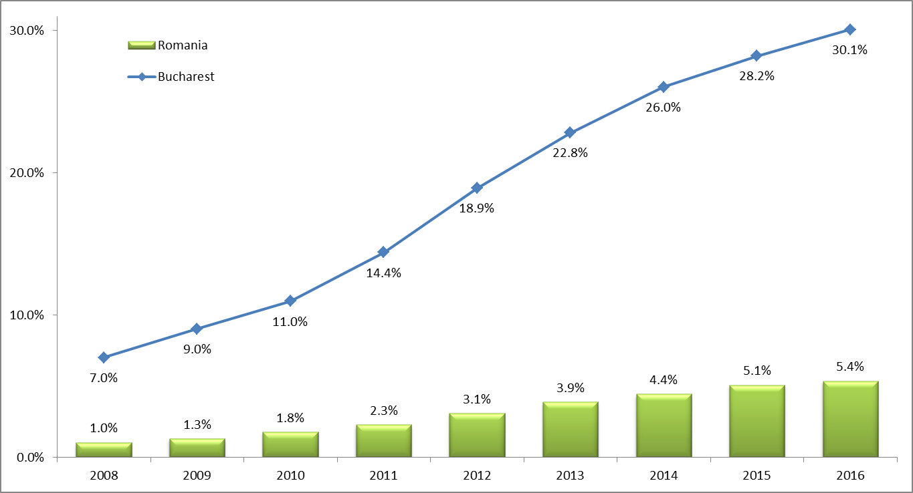
Market Share evolution
Achieving our 30% Target Market Share
in Bucharest in 2016
| 27

Slide 28
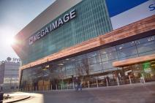
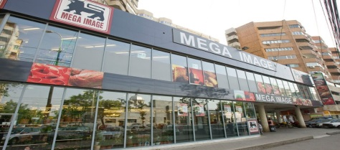
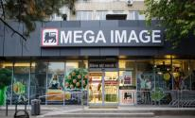
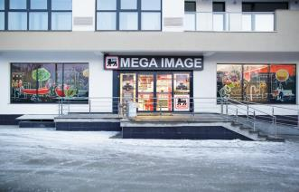
Mega Image Stores Formats
Concept
Medium
Small
City
4 Stores
Urban Center
+100 .000
87 Stores
Urban Center
+100 .000
60 Stores
Urban Center
+100 .000
79 Stores
Urban Center
+100 .000
Sqm: 1,700
Avg. Sales/Day: 25.6 KEUR
Clients/Day: 2,400
Basket: 11 EUR
Assortment: 12,600 SKU’s
Associates: 80
Capex: >1.5 MEUR
Price index KF: 97
Sqm: 850
Avg. Sales/Day: 14.4 KEUR
Clients/Day: 2,000
Basket: 7 EUR
Assortment: 10,600 SKU’s
Associates: 45
Capex: >800 KEUR
Price index KF: 97
Sqm: 500
Avg. Sales/Day: 10 KEUR
Clients/Day: 1,700
Basket: 6 EUR
Assortment: 7,800 SKU’s
Associates: 35
Capex: >600 KEUR
Price index KF: 97
Sqm: 300
Avg. Sales/Day: 6.7 EUR
Clients/Day: 1,600
Basket: 4 EUR
Assortment: 5,800 SKU’s
Associates: 30
Capex: >300 KEUR
Price index KF: 97
Enhance customers food experience
Increased Shopping Experience
Proximity and Assortment
Cover the expectation of the customers in proximity
New layout, new standards, new in-store experience
| 28
Notes:
#stores updated

Slide 29



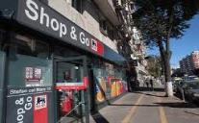
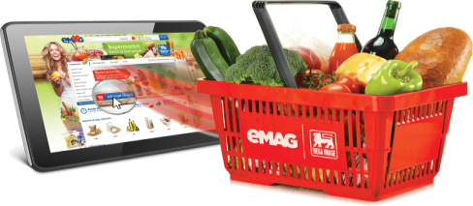
Mega Image Stores Formats
Shop&Go
ECommerce
294 Stores
Urban Center
Sqm: 100
Avg. Sales/Day: 2 KEUR
Clients/Day: 600
Basket: 3 EUR
Assortment: 2,500 SKU’s
Operational Franchise
Capex: 115 KEUR
Price index KF: 94
Drive Store
Pick-up Points
Home Delivery
Avg. Sales/Day: 5.6 KEUR
Clients/Day: 125
Basket: 45 EUR
Assortment: 11,800 SKU’s
Convenient food store
National Online Coverage
Proximity layout
Complete service for payment and delivery
| 29
Notes:
#stores updated

Slide 30
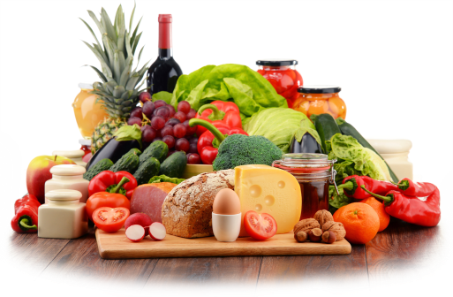
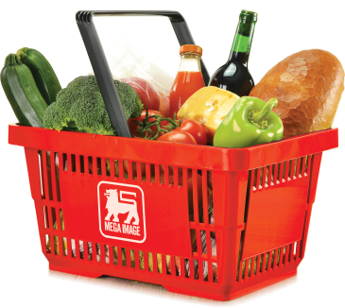
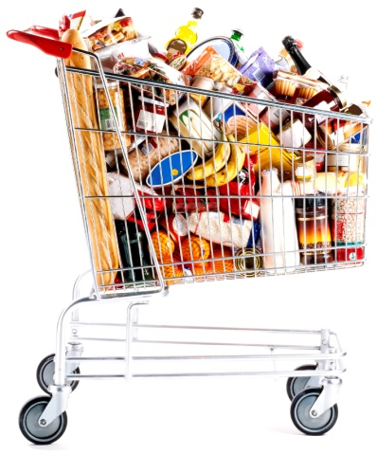

Categories Contribution
Fresh & perishable
41%
36%
Food Grocery
General Merchandise
(incl. Cigarettes 13%)
15%
8%
Non Food Grocery
Sales contribution
| 30

Slide 31



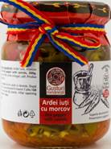


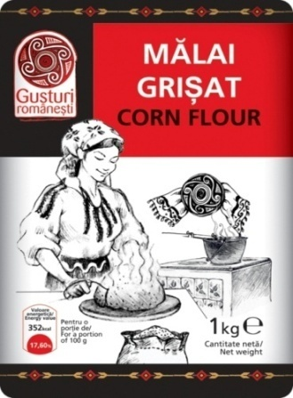




Private Brand – Pivot of our differentiation strategy
6,285 SKUs
(3,633 SKUs - Private Brands;
2,622 SKUs - Exclusive brands)
22.3 % Sales participation
(16.1% PB participation)
Premium/
Niche
56 SKUs
109 SKUs
Medium High
41 SKUs
346 SKUs
Local Private Brand related
to Traditional Romanian products
Medium
65 SKus
125 SKUs
884 SKUs
217 SKUs
Low Tier
717 SKus
1st Price
  C-Brands

Slide 32

Thank You!

