Slide 1
Sri Lanka: Next Trade and Investment Destination in Asia
Presentation by Mr. M P T Cooray
May 2017

Slide 2
South Asian Region
Quarter of the World Population
Accounts for 3% of global gross domestic product
1.9% of world exports
1.7% of world foreign direct investment
Home for 40% of the world poor with
29.5% population living on less than a dollar a day
This is the region where Sri Lanka is located.

Slide 3
Sri Lanka in a Nutshell
Demographics
Home for 21.4 mn people
90% is literate
70% is internet savvy
Human Development index (2015)
0.766 ranked 73 among 188 countries
Poverty Head count reduced from 15.3% in 2006 to 4.1% in 2016
Unemployment – 4.1%

Slide 4
Sri Lanka in a Nutshell cont’d….
Economic
GDP 2017 – US$ 87.2 bn
GDP per capita US$ 4065, a middle income economy
GDP growth rate 3.1 (2017)
Composition of GDP
Agriculture 7.8% from GDP (2017)
Industry 30.5% (2017)
Services 61.7% (est. 2017)
Export revenue – US$ 11.08 bn.

Slide 5
What is being done to Sustain the favourable economic outlook
Macro Economic Stabilization
Better Integration to the Global Economy
Improving Investment attraction
and Business climate

Slide 6
Sri Lanka is on an Ambitious Trade Reform Agenda
New Trade Policy
National Export Strategy
New Trade Facilitation
New Maritime & Logistics policy
(under preparation)

Slide 7
New Trade Policy
Rationalization of trade regime by eliminating para tariff, specific tariff and consolidating tariff lines into 2 or 3 brands
Strengthening and developing new institutional mechanism by reviewing current standards and further liberalization
New comprehensive FTAs
NES for export diversification
More liberalized regime of trading services
Liberalized foreign investment regime specifically targeting export seeking FDI
Facilitation of trade and improve trade logistics and implementation of WTO Trade facilitation agreement
Promote industries capable of integrating into global production networks
Safeguard measures for protecting domestic industry from dumping and unfair trade practices.

Slide 8
National Export Strategy
Focus Trade Support Functions
Priority Sectors – selected by NES for Export Diversification
Trade Information and Promotion
National Quality Infrastructure
Innovation and R&D
Logistics & Warehousing
Improved business environment for all export sectors through
Boating Industry
Electrical & Electronic
Processed Food & Beverages
Spice &
Concentrates
ICT/
BPO
Wellness
Tourism

Slide 9
Trade Facilitation
Sri Lanka Ratified WTO Trade Facilitation agreement 31 May 2016. 81st WTO member to ratify
Expected to improve awareness
Reduce trade costs
Improve export potential
Improve FDI attraction
Set up National Trade Facilitation Committee
Launched National Single window system to streamline export and import documents

Slide 10
New Maritime & Logistics Policy (under preparation)
Desire is to utilize locational logistic advantage of Sri Lanka and to develop new maritime hub with market driven policies and appointment of a regulator.
Further liberalization of shipping, logistics and ancillary services are being thought of.

Slide 11
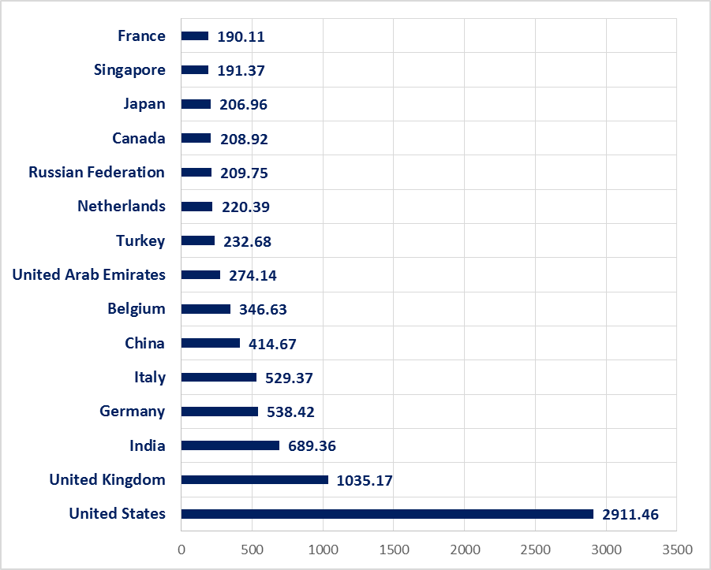
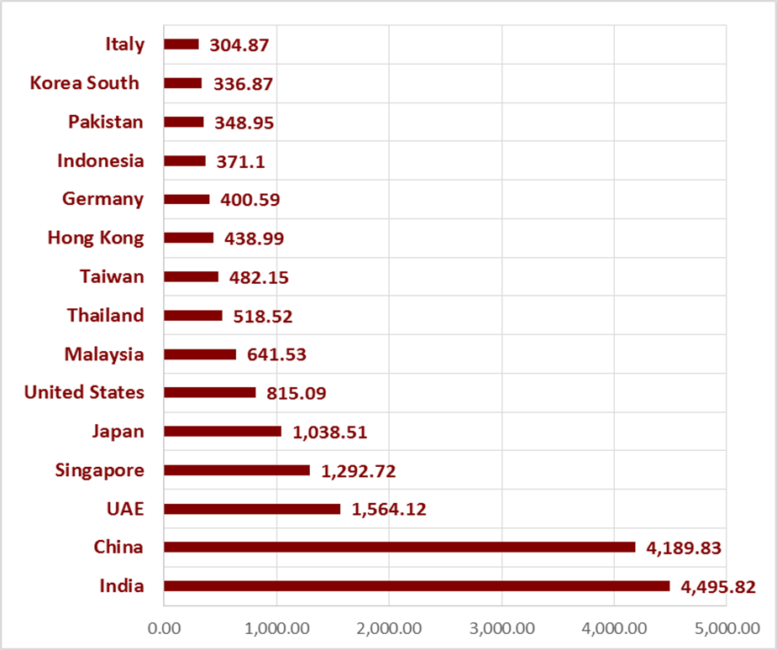
Sri Lanka as a Vibrant Trading Nation (US$ mn)
TOP EXPORT DESTINATIONS
TOP IMPORT SOURCES
Total Exports – 11.408 mn
To EU 3.301 mn (29%)
To USA 2.909 mn (26%)
Rest of the world 5.150 mn (45%)
Total Imports – 20.980 mn
From China 3.955 mn (18.9%)
From India 4.527 mn (21.6%)
From EU 712 mn (8.2%)
From USA 492 mn (2.3%)
Rest of the world 10.686mn (49%)
Source: Information Technology Division /Sri Lanka Export Development Board

Slide 12
Major Export Products
Tea
Cleanest Tea, ISO 3720 quality standards US$ 1,512.41 mn
Processed Food Products
Fruits, vegetables, confectionery, beverages US$ 114 mn
Seafood
34 EU approved plants,
Premium quality tuna
100% VMS licensed fishery vessels US$ 255.65 mn
Spices
Nutmeg, Mace, Cardamoms,
Ceylon Cinnamon, Essential oils US$ 399 mn
Apparel
Ethical Sourcing destination catering to all brands US$ 5,015.12 mn

Slide 13
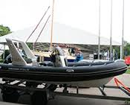
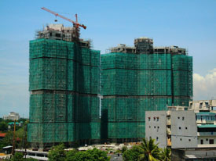
Major Export Products cont’d…
Rubber based products - US$ 873.34 mn
Gems & Jewellery
Leading sapphire supplier US$ 266.29 mn
Electronic & Electrical Sector
Automotive Electronics, PCB Assembly, Consumer Electronics US$ 353mn
Boat Building Sector – US$ 279 mn
ICT/BPO
Leading brands are operated - US 1.2 bn
Construction Service Sector
Designing, system planning, project management,
green construction US$ 60 mn

Slide 14
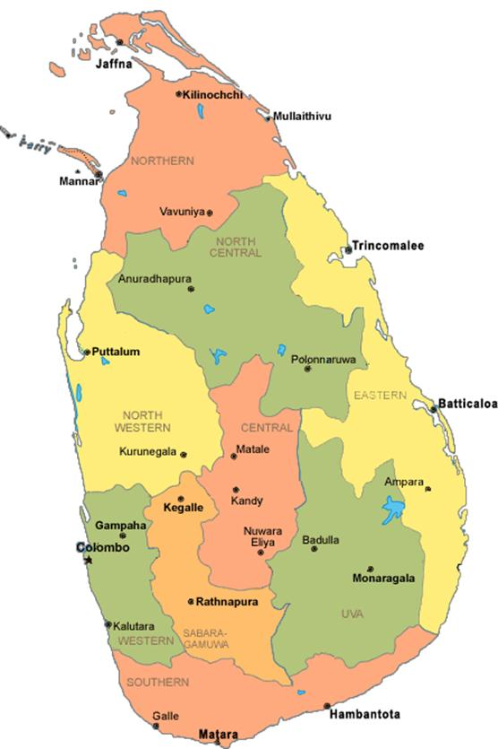
Free Ports & Bonded Areas
What are Free Port (FP) & Bonded Areas (BA) for the purpose of Finance Act 12 of 2012 ?
Areas “which are geographically inside Sri Lanka but are legally considered outside its customs territory”.
Entrepot Trade
Offshore business
Front end services
Operations of the Headquarters
Imports to FP /BA
Exports from FP/BA
Imports to SL from FP/BA
Katunayake
Admissions into FP/BA TZ : Duty Free
Exports from FP/BA : Duty Free
Imports to Sri Lanka from FP/BA : Dutiable
Colombo
Mattala
Mirijjawila
Koggala
Hambantota

Slide 15
An Investment Regime
Importance of FDI
eg. To achieve : 7% GDP growth rate per annum
Economic indicator | 2007-2016 (Actual) | 2020 (Targets)
GDP Growth – Average | 5.9% | 7%
National Investment – Average (as a % of GDP) | 30.8% | 35%
National Savings – Average (as a % of GDP) | 26.8% | 30%
FDI – Average (as a % of GDP) | 1.65% | 4 - 5%

Slide 16
FDI Trends – 1978 to 2017
USD Mn
Reaping the benefits of improvements made by the government to improve the investment environment

Slide 17
Strategies for New Investments
A) Identification of Target sectors
B) Identification of Lands for New Zones development
C) Policy & Regulatory Reforms
Initiate Establishment of New Zones
Identified
priority Manufacturing & Services sectors
To improve policy & regulatory environment
To offer predictability & sustainability

Slide 18
Identified 14 priority sectors
Manufacturing Sector
Electronics
Industrial Machinery
Automotive
Electrical Equipment
Fabricated Metal products
Food Products
Medical Devices
Basic Metals
Pharmaceutical s
Mineral Products
Sub Sectors
Solar Cells and related, Printed circuits
Production machinery, valves, pumps
Auto parts
Electricity panel boards, insulated wires
Screws, bolts, washers, nuts
Structural metal products
Fruits and vegetable processing, dairy
Comprehensive Analysis on all private sector activities
Service Sector
IT & Software Development
BOP/KPO
Tourism
Education

Slide 19
Policy & Regulatory Reforms
Policy Reforms
Consistent & Transparent Investment Policy
Moved away from Traditional Incentives of granting Tax Holidays
New Tax Incentive Regime based on Capital Formation in par with international best practices
Regulatory Reforms
New Inland Revenue Act No. 24 of 2017
New Foreign Exchange Act No. 12 of 2017
Amendments to Land (Restriction on Alienation) Act No. 38 of 2014
New Improved Co-ordination
Improved Line Agency Co-ordination through Single Window (SWIFT)

Slide 20
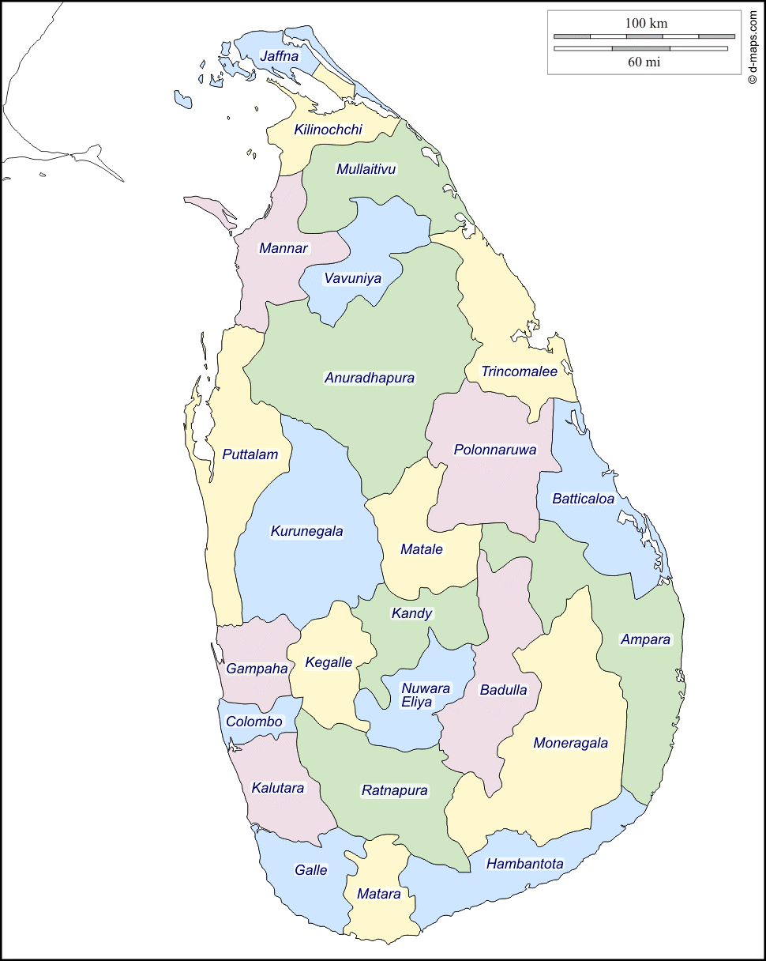
Development of Infrastructure
Proposed New Economic / Industrial Zones
Budgetary allocation USD 2.5 Bn for development of new zones
Along with Line Agencies, BOI to provide off site infrastructure
Investor to develop the zone on PPP basis
Joint promotion to attract investors by developer and BOI
Bingiriya
Mawathagama
Milleniya
Charlie Mount
(Matara)

Slide 21
Investment Promotion & Protection
Double taxation avoidance agreements
1 | Australia | 23 | Netherlands
2 | Bangladesh | 24 | Norway
3 | ​Bahrain | 25 | Oman
4 | Belgium | 26 | Pakistan
5 | Canada | 27 | Philippines
6 | China | 28 | Poland
7 | ​(Czech Republic) | 29 | Qatar
8 | Denmark | 30 | Romania
9 | France | 31 | Russia
10 | Finland | 32 | Saudi Arabia
11 | Germany | 33 | Singapore
12 | Hong Kong | 34 | Sweden
13 | India | 35 | Switzerland
14 | Indonesia | 36 | Thailand
15 | Iran | 37 | U.A.E.
16 | Italy | 38 | U.K.
17 | Japan | 39 | U.S.A
18 | Korea | 40 | Vietnam
19 | Kuwait | 41 | Seychelles
20 | Malaysia | 42 | Belarus
21 | Mauritius | 43 | Palestine
22 | Nepal | 44 | Luxembourg
Bilateral Investment Promotion & Protection Treaties
1 | Australia | 15 | Korea, Republic of
2 | Belgium-Luxembourg | 16 | Kuwait
3 | China | 17 | Malaysia
4 | Czech Republic | 18 | Netherlands
5 | Denmark | 19 | Norway
6 | Egypt | 20 | Pakistan
7 | Finland | 21 | Romania
8 | France | 22 | Singapore
9 | Germany | 23 | Sweden
10 | India | 24 | Switzerland
11 | Indonesia | 25 | Thailand
12 | Iran, Islamic Republic of | 26 | United Kingdom
13 | Italy | 27 | United States of America
14 | Japan | 28 | Viet Nam

Slide 22
Opportunities in
Colombo International Financial City (CIFC)
(CIFC)
The Colombo International Financial City (CIFC) ; A Special Financial Zone that Is planned to become an Offshore Financial Centre.
Already attracted numerous investors from all over the world.
60% of reclamation work is completed
The Colombo Port City when completed would
see an investment of Us$15 Billion
83,000 new employment opportunities

Slide 23
Importance of EU Market
EU is already an important trading partner to Sri Lanka as an export destination
Significant FDI contributor
It offered unilateral non reciprocal trade preferences known as GSP+ in recognition for the commitment of good governance, human rights and rule of law

Slide 24
Exports to EU
To the EU 2006-2017 (US$ Mn)
In 2017 EU market share was 29% percentage of total exports of Sri Lanka
Source: SL Custom Returns/ITC

Slide 25
Investment Projects from EU (In Commercial Operation)
UK is the major source of investment from EU followed by Germany, Netherlands, Sweden, Italy etc.
64% of projects are from manufacturing, Apparel & Agro Processing sectors while 36% projects are from other sectors such as infrastructure, utilities, hotels etc.
30 more pending projects from EU of which 13 are export-oriented.

Slide 26
Investment Projects from EU – Sector wise (240 Projects in Commercial Operation)
Manufacturing Including Apparel and Agro Processing projects represents 64% of total EU Projects

Slide 27
EU GSP+ and what it means to Sri Lanka
HS code | Product Description | MFN Tariff Range | Tariff range under Standard GSP | Tariffs under GSP Plus
61 | Knitted and Crocheted Apparel | 8.9% - 12% | 7.1-9.6% | 0%
62 | Woven Apparel | 8.9% - 12% | 7.1-9.6% | 0%
40 | Rubber & Articles | 0% - 4.5% | 0% | 0%
03 | Seafood | 7.5% - 18% | 2.6-14.5% | 0%
87 | Vehicles other than railway | 1.7% - 15% | 0-10.5% | 0%
85 | Electrical machinery & equipment | 2.1% - 3.7% | 0% | 0%
21 | Miscellaneous edible preparations | 0% - 14% | 0% - 9.8% | 0%
63 | Other made-up textile articles | 2% - 12% | 1.6% - 9.6% | 0%
95 | Toys games &sports items | 1.7% - 4.7% | 0% - 1.2% | 0%
64 | Footwear | 3.5% - 17% | 0% - 11.9% | 0%

Slide 28
How EU GSP+ works in Sri Lanka
Utilization Rates of Major Sectors
(%)

Slide 29
Potential Products for Sourcing & FDI

Slide 30
ON TRADE
It offers market access to USA through GSP
To EU through GSP+
To the region through bilateral and multilateral trade agreements with China, India, Singapore, Pakistan, APTA, AFTA, SAPTA
In future to Thailand, Malaysia and Bangladesh
ON INVESTMENT
Through a predictable fiscal environment
A clear FDI entry policy
Liberalized predictable international payment regime
And protection through Investment promotion and protection agreements and double taxation avoidance agreements
Therefore I invite all of you to look at Sri Lanka as a sourcing destination and as an investment destination. I am sure you will not regret and will be fascinated by Sri Lankan hospitality

Slide 31
Thank You

