Slide 1
Almost 100 years of expertise in trade credit insurance

Slide 2
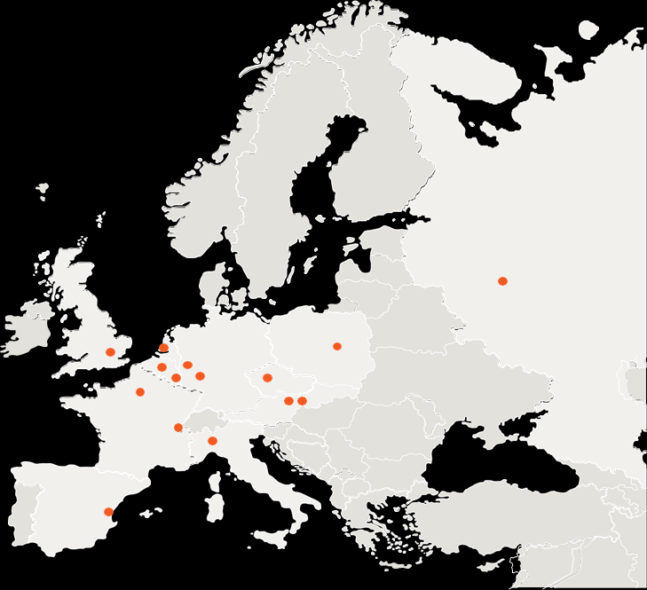
About Credendo
European trade credit insurance group
Covers commercial and political risks
Active in all segments of trade credit insurance
Present in 14 countries in Europe

Slide 3
Our mission
Our mission is to support trade relations
Credendo provides tailor-made solutions of
Insurance
Guarantees
Bonding (Surety)
Financing
Reinsurance
related to domestic and international trade transactions or investments abroad
We protect:
Companies
Banks
Insurance undertakings
TURNING UNCERTAINTIES INTO OPPORTUNITIES

Slide 4
Our values
1
Customer intimacy
3
Reliability
You get bespoke solutions
You can count on us
2
Respect
You can trust us

Slide 5
Corporate Social Responsibility
Credendo’s Corporate Sustainability Policy:
integrity
corporate sustainability
human rights
environmental sustainability
fight against corruption
=> commitment to the United Nations SDGs
Notes:
As part of the broader sustainability framework within Credendo, the corporate sustainability policy describes the vision of Credendo – Export Credit Agency and its subsidiaries regarding integrity, corporate sustainability, human rights and environmental sustainability, the fight against corruption, and Credendo’s commitment to the United Nations’ Sustainable Development Goals (SDGs).
Credendo promotes and encourages its counterparties to implement the OECD’s "Guidelines for Multinational Enterprises", a set of recommendations which can help companies to avoid and address adverse impacts in areas such as employment and industrial relations, human rights, the environment, information disclosure, combating bribery, consumer interests, science and technology, competition and taxation.
Credendo focuses on the 11 SDGs where it believes that it may have the biggest impact through its own activities and credit insurance business. This impact can be both direct and indirect.
Direct impact: Credendo promotes equal opportunities, diversity, non-discrimination and gender equality when it comes to recruitment and employment. Credendo takes care of its employees by promoting a healthy lifestyle both at work and at home. Credendo strives to become an overall CO₂-neutral and zero-waste organisation. Credendo promotes and focuses on several well-being initiatives for its staff. Credendo also uses environmental and sustainable criteria when selecting its own suppliers.
Indirect impact: Credendo strives to conduct its business in a responsible and sustainable way, and promotes responsible and sustainable business practices regarding the environment, human rights, combating corruption and the promotion of sustainable lending to lower-income countries.
Credendo developed due diligence procedures – supported by the necessary policies and internal control systems – to identify, prevent, mitigate and account for how it addresses actual and potential adverse impacts on its operations and business relationships.

Slide 6
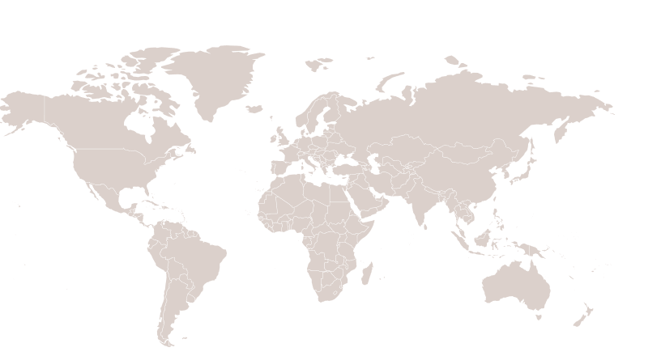
Credendo in figures
Credendo – Export Credit Agency
Credendo – Single Risk
Credendo – Ingosstrakh Credit Insurance
Credendo – Short-Term EU Risks
Credendo – Short-Term Non-EU Risks
Credendo – Excess & Surety
Headed by the Belgian Export Credit Agency
1921
Almost 100 years of experience in credit insurance
16 offices in 14 European countries
Geographical spread of risk exposure
4%
North
America
32%
European Union
8%
Other European countries
29%
Asia
520
employees
11%
Central & South
America
Values of transactions insured in 2018: 87 billion €
16%
Africa
1%
Oceania

Slide 7
Tailor- made trade insurance solutions
Trade Credit Insurance
Investment Insurance
Bonding (Surety)
Reinsurance
Financial guarantees
Financing

Slide 8
How to ease access to bank credit at your belgian bank :
Financial Guarantee for bank credit

Slide 9
Financial Guarantees for bank credits
Trade Credit Insurance
Investment Insurance
Bonding (Surety)
Reinsurance
Financial guarantees
Financing

Slide 10
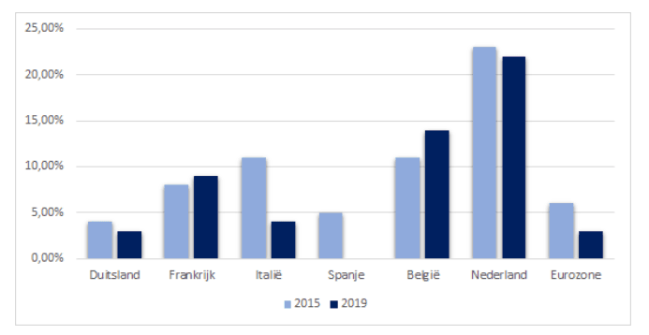
Financial Guarantees for bank credits
Financing Gap
Source : Euler Hermes

Slide 11
Financial Guarantees for bank credits
Background
Financing Gap
Companies need to grow
Growth requires investments
70% of these investments are provided by the banks
need for alternative financing increases
Trends (02/05/2019) : “ Belgische bedrijven blijven banken trouw “
Solution : ease access to bank financing

Slide 12
Financial Guarantees for bank credits
Background
SME’s face difficulties to obtain the necessary credit lines to finance their normal course of business
Financial crisis :
All Belgian companies (not only SME’s): need for new financing/liquidity but hard to obtain
Banks: not sufficient capacity to provide required financing/liquidity
Credendo fills this “gap” by risk participating behind the bank: “Financial Guarantee”

Slide 13
Financial Guarantees for bank credits
Product characteristics
Eligible for Belgian companies with international operations
Participation of max 50%
Request from bank or Belgian company for new transactions but the intention is to support the company
Credendo is not allowed to support companies facing financial distress
Credendo pari passu with bank (securities)
Risk & Fee sharing principle
Credendo’s support must be disclosed to the Belgian company

Slide 14
Financial Guarantees for bank credits
Eligible deals (1/2)
Working Capital:
To finance a company’s business cycle (cf. purchase of goods, production, sales)
Specific credit for a single transaction or general credit facility
Use of proceeds should be as specified as possible
Investment Credits:
MLT financing of fixed assets (cf. buildings, equipment, etc.)
Acquisition or start-up of an overseas company

Slide 15
Financial Guarantees for bank credits
Eligible deals (2/2)
Bond Credit Facilities:
Bid, performance, advance payment bonds, etc.
Issuance of L/C’s
Private Placements
MLT bond issue for investments (private placements target a limited number of investors (<50) and no active marketing can be done by the issuing company)
Credendo can enhance the risk profile of the bond by providing a guarantee to the bond holders
Bank acts as agent; agency agreement concluded between Credendo and the bank
Credendo at any time pari passu with bondholders
Fee sharing is not possible. Attention to market conformity of the pricing

Slide 16
Financial Guarantees for bank credits
Procedure
#
Bank
Credendo
1
Initial request
Preliminary (non-binding) indication
2
Official request & detailed information (e.g. credit memo & financials)
Decision Credendo (Offer of Cover)
3
Deal structuring & final credit approval
(Potential) client meeting & insurance cover consult
4
Draw up and distribution documentation (Participation Certificate)
Fine-tuning & signing PC
5
Monitoring
Policy Management

Slide 17
“The Great Lockdown”:
Credendo ECA support mechanisms
Credendo Bridge Guarantee
Reinsurance program

Slide 18
Helping exporters overcome COVID-19 crisis:
Credendo ECA’s Bridge Guarantee

Slide 19
Credendo Bridge Guarantee
Trade Credit Insurance
Investment Insurance
Bonding (Surety)
Reinsurance
Financial guarantees
Financing

Slide 20
Credendo Bridge Guarantee
Background
Exports : >85% of Belgian GDP
COVID-19 crisis is origin of cash flow problems at Belgian exporting companies
Restart of Belgian economy and exports require bridge loans by banks (government initiative)
Similarities with financial crisis 2008 - 2009 :
All Belgian companies (not only SME’s): need for new financing/liquidity but possibly hard to obtain
Banks: capital restraints hamper capacity to provide required financing/liquidity
Credendo tackles this “hurdle” by risk participating behind the bank: “Credendo bridge guarantee”

Slide 21
Credendo Bridge Guarantee
Rationale
Ensuring that Belgian exporting companies (SME’s in particular) have access to the necessary credit lines they need to finance (“brigde”) their liquidity requirements in Belgium for the next 12 months in order to avoid a systemic crisis in the country
First demand guarantee product offered to financial institutions operating in Belgium, covering up to 80% or EUR 10 M of the credit risk related to new loans
Guaranteed loans will finance the working capital and investment needs of the borrower
No additional cost for borrowers and immediate positive impact on banks’ capital requirements
Falls under existing framework agreement with the banks
Enhancement of the EUR 50 Bn Belgian State Guarantee scheme (Royal Decree of 14 April 2020)

Slide 22
Credendo Bridge Guarantee
Key requirements – borrower
Eligible for Belgian companies with international operations (i.e. whose exports represent at least 30% of their turnovers)
Borrower must not be in financial difficulty on 31 December 2019 (as per EC regulation)
Borrower must not have payment arrears on its outstanding credits on 1 February 2020, nor be subject of a credit restructuring by its banks on 31 January 2020

Slide 23
Credendo Bridge Guarantee
Key requirements – credit agreement
Credit needs to fall under the EUR 50 Bn Belgian State Guarantee scheme (Royal Decree of 14 April 2020)
Credit needs to finance the liquidity needs for the coming 12 months
Interest margin charged by the bank on the loan is capped at 1,25% p.a.
Only new credits that are granted between 1 April 2020 and 30 September 2020 are considered (no refinancing of existing loans)
Amount of the credit can not exceed:
Double the annual wage bill of the borrower, or
25% of the borrower’s 2019 turnover
Exceptionally, the above two criteria can be breached when they don’t represent a good proxy of the actual liquidity needs of the borrower for the next 12 months

Slide 24
Credendo Bridge Guarantee
Key requirements – Credendo Bridge Guarantee
Maximum guarantee amount : EUR 10 M
Guaranteed percentage ranges between 20% and 80%
Maximum tenor : 12 months
Pricing : Credendo’s pricing is set as 100% of the bank’s net margin (i.e. the interest margin less the bank’s cost of funds), pro rata Credendo’s guaranteed portion
Offered on pari passu terms: Credendo shares in all general and credit-agreement specific securities that the bank benefits from

Slide 25
Credendo Bridge Guarantee
Example
Maximum amount of the CBG :
turnover of the SME : € 45mio for the year 2019
Equity position of the borrower : € 10mio as of 31/12/2019
Amount of the bridge loan : € 4 mio
The CBG amount would be the lesser of :
€ 10mio;
80% of € 4mio = € 3,2mio
30% of the borrower’s equity on 31/12/2019 = € 3mio
The CBG amount would thus be limited to € 3mio, which is a 75% guarantee.

Slide 26
Credendo Bridge Guarantee
Example
Pricing of the CBG :
Interest rate charged by the bank (capped at 125 bps), and
Portfolio Guarantee remuneration, due to the Belgian State : 25 bps (for SME’s) or 50 bps (large corporates)
A CBG-covered credit to a SME with the following features :
Amount of the credit : € 8mio
Tenor of the credit : 12 months
Interest rate : 125 bps per annum
Bank’s cost of funding : 5 bps per annum
Remuneration fee for the Portfolio Guarantee : 25 bps
CBG guaranteed percentage : 80%
Fee payable by the borrower to the State pursuant to the Portfolio Guarantee :
25 bps x € 8mio = € 20.000

Slide 27
Credendo Bridge Guarantee
CBG and Portfolio Guarantee : key parameters
Feature/scheme | Credendo Bridge Guarantee | Portfolio Guarantee
Targeted beneficiaries | Internationally active companies facing liquidity issues due to COVID-19 | Broader scope than the CBG, including, for instance, ‘independent workers’
Approval process | Case-by-case approval: The CBG only applies to qualifying credits under the Portfolio Guarantee and to borrowers fulfilling Credendo’s requirements | Automatic approval: The Portfolio Guarantee applies automatically to all qualifying credits
Risks covered | Non-payment under a single Credit Agreement | Final loss under a portfolio of qualifying Credit Agreements
Type of cover | First-demand guarantee | Guarantee covering the remaining loss post enforcement of all sureties and guaranties available
Guaranteed rate | Up to 80% (min. 20%) | Specific per tranche depending on the final loss recorded in the portfolio of qualifying credits

Slide 28
Credendo Bridge Guarantee
CBG vs Financial Guarantee : main differences
Feature/product | Credendo Bridge Guarantee | Financial Guarantee
Tenor | Up to 12 months | No strict maximum tenor
Amount | Up to EUR 10 m | No strict maximum amount
Guaranteed rate | Up to 80% (min. 20%) | Up to 50%
Types of Credit Agreement | Credit agreements financing the general liquidity needs of the borrower for the following 12 months, which may include investment and working capital costs | Credit agreements (preferably) financing specific needs linked to the borrower’s contracts or projects: Working capital loans Capex loans Bonding facilities
Financial situation of the Borrower | The borrower must not have been in financial difficulties before the covid-19 crisis but at the time of the CBG submission it can be facing or be expecting to face liquidity issues in the future Financing for exceptional liquidity requirements | The borrower must not have been in financial difficulties before the covid-19 crisis and must not be facing or expecting to face extraordinary financial issues during the tenor of the financing Financing for ‘business as usual’

Slide 29
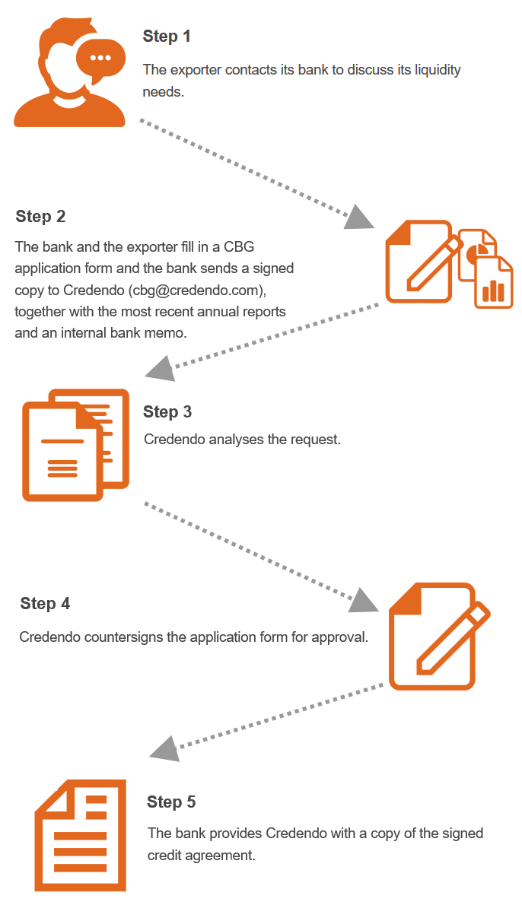
Credendo Bridge Guarantee
CBG procedure

Slide 30
Helping the insurance sector overcome COVID-19 crisis:
Credendo ECA’s reinsurance program

Slide 31
Credendo State reinsurance program
Trade Credit Insurance
Investment Insurance
Bonding (Surety)
Reinsurance
Financial guarantees
Financing

Slide 32
Credendo State reinsurance program
Background
Exports : >85% of Belgian GDP
Short-term private credit insurance (<2y payment terms) : € 57bn outstanding credit limits on behalf of Belgian exporters
EC: “imminent insufficiency of private insurance capacity for exports to all countries” …
… while demand for insurance will significantly rise as a result of the current crisis.
Normally: massive suspension of credit limits by private credit insurance companies
European Commission agreed on State Aid Temporary Framework to support the economy in the context of the COVID-19 outbreak (19 March 2020) : all countries are non-marketable
Several other EU-27 countries launching support programs (Germany, The Netherlands, France, …) for national private credit insurance sector
Under aegis of NBB, negotiations start with Belgian State, Credendo ECA, Assuralia and private credit insurers (Atradius, Euler-Hermes, Credendo STN, Credendo XS and Coface)

Slide 33
Credendo State reinsurance program
Principles
Eligible for Belgian private insurance companies providing short-term commercial credit insurances (listed before)
MoU : mitigate the risk of lack of credit insurance for insured companies located in Belgium for their commercial transactions with buyers (debtors) based both in Belgium and abroad
The credit insurers commit to keep the credit limits actually used in the 12 months preceding 1 March 2020 as intact as possible until the end of the year 2020.
Credendo – Export Credit Agency, acting on behalf of the State, will be the reinsurer
Agreement on compensation to be borne by the insurers and (progressive) sharing of premiums between the insurer and Credendo, depending on the loss ratio.

Slide 34
Credendo = source of information

Slide 35
Credendo Risk App
--
Download for free!

Slide 36
Market information
Market information
Monthly Newsletter sent by e-mail
To register visit https://www.credendo.com/newsletter_subscription and subscribe
Country Annexes sent by e-mail
Sent to insured party highlighting changes to country categories and restrictions Mandate collection
Online Country Information System:
Visit https://www.credendo.com/country_risk. Click and select a country from the drop-down list or click on the map of the world where the country is located to view its ratings and restrictions.

Slide 37
Contact details
Wim Bosman
Business Development Specialist
<first name> <name>
<Title>
T +32 (0)2 788 89 37
M +32 (0)478 631 030
w.bosman@credendo.com
E x.xxxxx@credendo.com
T +00 0 000 00 00
M +00 000 000 000
www.credendo.com

