Slide 1
An overview of the EBRD
May 2016

Slide 2
Contents
Introduction to EBRD
EBRD in Romania
Financing Instruments
Municipal and Environmental Infrastructure
Selected Investments

Slide 3
What is the EBRD?
EBRD’s activities
EBRD in Romania
Financing instruments
MEI
Contact
The EBRD is investing in changing people’s lives and environments in more than 30 countries that stretch from central Europe to Central Asia, the Western Balkans and the southern and eastern Mediterranean and more recently Cyprus and Greece.
With an emphasis on working together with the private sector, we invest in projects, engage in policy dialogue and provide technical advice that fosters innovation and builds sustainable and open-market economies.
Owned by 67* countries and two
inter-governmental institutions
(the EU and EIB)
Capital base of €30 billion
*Libya is yet to become a fully ratified member of the EBRD
Cumulative business volume of
€107.2 billion as at end of 2015
Note: As at 31 December 2014

Slide 4
EBRD’s objectives achieved through financing the private sector
EBRD’s activities
EBRD in Romania
Financing instruments
MEI
Selected Investments
Results since inception (1991)
  More than €107 billion
  in over 4,400 projects
Results in 2015
  €9.4 billion invested
  in 381 projects
  Private sector accounted
  for 70% share
Note: as at January 2015

Slide 5
The EBRD and its objectives
EBRD’s activities
EBRD in Romania
Financing instruments
MEI
Selected Investments
“To promote transition to market economies by investing mainly in the private sector”
  “To mobilise significant foreign direct investment”
  “To support privatisation, restructuring and better municipal services to improve people’s lives”
  “To encourage environmentally sound and sustainable development”

Slide 6
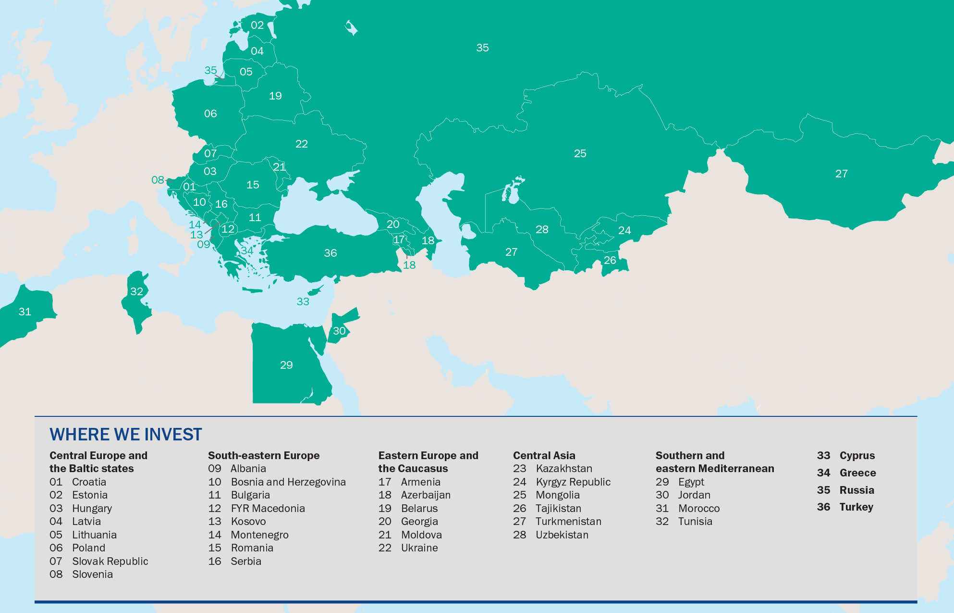
Where we invest
EBRD’s activities
EBRD in Romania
Financing instruments
MEI
Selected Investments

Slide 7
Key strengths of the EBRD
EBRD’s activities
EBRD in Romania
Financing instruments
MEI
Selected Investments
Operational
  Extensive knowledge of local economy, business environment and practices, local presence
  Engaged minority partner for business
  A business partner who shares risks, including political
  Catalyst to access additional equity, debt and trade finance
  Provides finance to both private and public sector clients
  High standards for corporate governance and compliance
Institutional
  Strong, internationally recognised financial partner with long-term perspective
  Close working relationships with governments and shareholders
  Political leverage due to EBRD’s unique mandate and shareholder structure
  Preferred Creditor Status
  Triple-A credit rating
  Work closely with market sources of capital to fill “market gaps”

Slide 8
EBRD Product Flexibility tailored to project needs
EBRD’s activities
EBRD in Romania
Financing instruments
MEI
Selected Investments
Equity
  Common stock or preferred
  Minority position only (up to 35%)
  Mezzanine
  Other
    guarantees
    currency swaps
Loans
  Senior, subordinated, convertible
  LT (up to 10y or more) or
  ST revolving
  Floating/ Fixed rates
  Choice of currencies
  (€, US$, RUB etc.)

Slide 9
EBRD finances diverse range of enterprises
EBRD’s activities
EBRD in Romania
Financing instruments
MEI
Selected Investments
Note: as at 31 December 2015

Slide 10
Romania - General Information
EBRD’s activities
EBRD in Romania
Financing instruments
MEI
Selected Investments
  Country of operation since 1992.
  €7.2 billion invested in Romania in 382 projects to date
  74% of the EBRD’s investments in Romania are in the private sector
  21% of the EBRD’s investments in Romania are in equity
  €2.0 billion current portfolio of projects, comprised of 175 active operations.
  Team of 15 bankers in Resident Office in Bucharest
  Strategic directions in Romania:
  Broadening access to finance by inducing lending and developing capital markets
  Reducing regional disparities and boosting inclusion through commercialised infrastructure
  Enhancing private sector competitiveness through targeted investment

Slide 11
EBRD – Investment terms
EBRD: Investment terms
EBRD’s activities
EBRD in Romania
Financing instruments
MEI
Selected Investments
  Flexibility of instruments offered –equity, quasi-equity, loans plus combinations
  Capacity to invest between €3/5 million and €200 million
  Equity: minority investor only – up to 35%
  Debt/mezzanine: up to 35% of total balance sheet or project costs
  Appetite for risk whilst supporting, rather than replacing, private investors
  Focus on environmentally sound projects
24 May, 2016
11

Slide 12
EBRD – Debt Finance
EBRD’s activities
EBRD in Romania
Financing instruments
MEI
Selected Investments
  Maturity and interest rates depend on the project’s risks associated with the project structure, client and market conditions
  EBRD can offer longer maturities than the commercial banks
  EBRD can provide large amounts of finance where needed
  Availability of financing for long term working capital
  Excellent relationships with commercial banks: access to commercial co-financing
  Loan Syndications (A/B structures)
  Mezzanine / subordinated debt
24 May, 2016
12

Slide 13
EBRD – Equity investments
EBRD: Equity Investments
EBRD’s activities
EBRD in Romania
Financing instruments
MEI
Selected Investments
  Maturity and interest rates depend on the project’s risks associated with the project structure, client and market conditions
  Companies that cannot expand with debt alone
  Owners who see the benefits of sharing equity and EBRD support in strengthening corporate governance
  Growth potential and strong competitive prospects in local markets and export markets
  Sound financial basis and financing plans
  Well-developed business plans and capacity to implement them
  Clear exit route for the Bank – sale to strategic or financial investor or an IPO
  Typical holding period for the Bank is 4-6 years
24 May, 2016
13

Slide 14
Project Cycle
EBRD’s activities
EBRD in Romania
Financing instruments
MEI
Selected Investments
Provided all necessary information is available, a project from Origination to Board Approval typically takes 3 to 6 months, depending on the complexity, length of negotiations and other factors
The total project cycle from origination to final repayment can range from 1 year, for working capital or trade financing projects, to 10 years for long term investments
EBRD financing in individual projects has ranged from less than €1 million to more than €150 million
Monitoring
Due Diligence
24 May, 2016
14

Slide 15
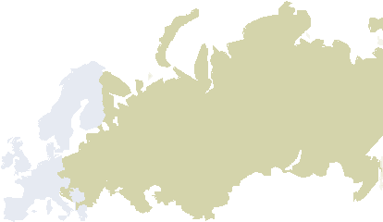
EBRD’s role in the municipal sector
EBRD’s activities
EBRD in Romania
Financing instruments
MEI
Selected Investments
Financing of municipal infrastructure, equipment and services to improve service levels
Promote commercialisation and corporatisation of services
Development of regulatory structures
Promotion of private sector involvement, where appropriate
Environmental, social, health and safety improvement
Facilitate donor grant and commercial loan co-financing
EBRD has an outstanding implementation track-record
24 May, 2016
15

Slide 16
Key areas in the municipal sector
EBRD’s activities
EBRD in Romania
Financing instruments
MEI
Selected Investments
Water & Wastewater – New and rehabilitated water and waste water treatment plants, network rehabilitation and extensions as well as pumps and metering to improve the quality of service and environmental compliance;
Urban Transport – improved public transport services (buses, LRT, metro, ferries, etc.) and more efficient and safe network design
Solid Waste Management – Investment in new landfills, recycling and collection equipment to improve both the efficiency and frequency of collection and well as to prevention of groundwater contamination
District Heating – renewal of obsolete heating and distribution systems to promote efficiency gains
Street Lighting – renewal of obsolete street lighting systems
Energy Efficiency
24 May, 2016
16

Slide 17
Three operating pillars in the sector
EBRD’s activities
EBRD in Romania
Financing instruments
MEI
Selected Investments
Decentralisation
Bring decision-making close to people (municipal or regional level)
Commercialisation
Commercialised service, not necessarily commercial service
Environment
Improve EHS living standards
Establish accountability to citizens (transparency and governance)
Lend money and ensure repayment at local level
Top line effort for cost-reflective tariff, improved collection
Bottom line effort for restructuring, cost cutting, management turnaround
PSP as appropriate (value-for-money, competition, transparency, fairness)
Social issues incl. stakeholder engagement, inclusion, gender
Mitigate climate change (2/3rd of 2013 investments contribute to energy efficiency)
24 May, 2016
17

Slide 18
Financing to match client capacity
EBRD’s activities
EBRD in Romania
Financing instruments
MEI
Selected Investments
Sovereign-backed loans
Cheap but can become politicised
Municipality loans
Self-financing independence for cities
Higher cost and burden on city debt book
Utility loans supported by cities
Borrowing by utility
Need to be backed by Public Service Contract + Support Agreement
Utility corporate loans or bonds
Self-financing independence for utilities
Entirely based on company creditworthiness / PSC
PPP/conces-sionaire loans to private companies
Private sector indebtedness
EBRD is flexible and has risk appetite-- we structure projects across the whole spectrum, e.g., from sovereign loans when legally necessary, municipal loans, public utility loans backed by municipal guarantee, operational concessions (DBOM), PPPs based on DBFO to full privatizations
24 May, 2016
18
18

Slide 19
EBRD loan financing parameters
EBRD’s activities
EBRD in Romania
Financing instruments
MEI
Selected Investments
Size €10 »» 200+ million (EBRD account)
Long maturities
Local currency, where possible
Market pricing linked to risk and tenor
Up to 18 years (public sector) and 18-20 years (PPPs) including 3-4 years grace
Security and other project support
Currency reference rate + margin
Fixing possible
Sovereign guarantees
Project Support Agreements
Municipal Guarantees
Assets/revenue pledge
Debt Service Reserve Account
10 June 2015
19

Slide 20













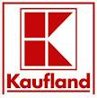






Romania – Selected corporate clients
EBRD’s activities
EBRD in Romania
Financing instruments
MEI
Selected Investments
Clients of the EBRD in Romania range from major international industry players to local medium and small sized companies
24 May, 2016
20

Slide 21



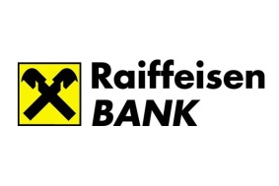
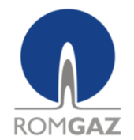

Capital Markets transactions
EBRD’s activities
EBRD in Romania
Financing instruments
MEI
Selected Investments
Bucharest Bond
Romania, 2015
EUR 75 million
Electrica
Romania, 2014
EUR 444 million
IPO
Bucharest Stock Exchange
Romania, 2014
Equity investment
EUR 3 million
Bond subscriptions
2014: EUR 25.1 million
2013: EUR 12.7 million
Romgaz
2013
EUR 50 million
IPO
Transelectrica
2013
RON 200 million
Bond
24 May, 2016

Slide 22

Case Studies – Profi expansion
EBRD’s activities
EBRD in Romania
Financing instruments
MEI
Selected Investments
Project Summary
Client
Profi Rom Food
Signed in
2016
A delegated facility for equity and quasi-equity investments, as well as tailor-made debt financing
Established jointly by the EBRD and the Italian Government in 2006
For investments in the Balkans (Albania, Bosnia & Herzegovina, Bulgaria, Croatia, FYR Macedonia, Kosovo, Montenegro, Romania, Serbia), Turkey, and the SEMED region (Egypt, Jordan, Morocco, Tunisia)
To meet the growing financing needs of dynamic local SMEs, not sufficiently supported by other financing sources
Country
Romania
Product
Senior debt - Parallel
Geographic expansion of the Bank’s region
of operations
Sector
Retail
Amount
EUR 25 m
Highlights
Profi is a leading food retailer in Romania, owned by Polish Enterprise Fund VI, a private equity fund managed by Enterprise Investors.
The Bank’s financing is parallel to a EUR 15 million loan from a commercial lender. The loan would be used to finance the expansion of Profi’s retail network in rural areas of Romania and the company’s working capital needs following a capital structure optimisation transaction.
The transition impact of the project is expected to stem from expansion of modern retail operations into smaller towns of Romania and setting standards of corporate governance and business conduct, in particular with respect to potentially improving standards of energy efficiency in existing and new stores.
24 May, 2016

Slide 23

Green Group – equity investment
EBRD’s activities
EBRD in Romania
Financing instruments
MEI
Selected Investments
Project Summary
Client
Green Group
Signed in
2011
A delegated facility for equity and quasi-equity investments, as well as tailor-made debt financing
Established jointly by the EBRD and the Italian Government in 2006
For investments in the Balkans (Albania, Bosnia & Herzegovina, Bulgaria, Croatia, FYR Macedonia, Kosovo, Montenegro, Romania, Serbia), Turkey, and the SEMED region (Egypt, Jordan, Morocco, Tunisia)
To meet the growing financing needs of dynamic local SMEs, not sufficiently supported by other financing sources
Country
Romania
Product
Equity
Geographic expansion of the Bank’s region
of operations
Sector
Recycling
Amount
EUR 6.8mn
Highlights
Green Group is the only waste recycling integrated park from Romania and was set up following the acquisition of the majority stake by Global Finance’s South East Europe Fund (SEEF) in consortium with EBRD from Romcarbon.
Green Group consists of GreenTech SA (PET bottles recycling), GreenFiber Internațional SA (PET fiber producer), GreenWEEE Internațional SA (WEEE recycling) and GreenLamp Reciclare SA (lamp and baterries recycling)
The total investment value of EBRD and SEEF in Green Group reached EUR 22.7 million. The project represents a major capital transaction in the recycling industry field and will sustain the Green Group’ strategy in becoming the most important waste recycling park in SE Europe.
South East Europe Fund is a private equity fund managed by Global Finance, an independent investment firm that pioneered private equity in the region. The EBRD is one of the anchor investors in SEEF.
23

Slide 24
Renault Technologies Romania - Titu Test Centre
EBRD’s activities
EBRD in Romania
Financing instruments
MEI
Selected Investments
Project Summary
Client
RTR
Signed in
2009
Country
Romania
Product
Portage equity
Sector
Automotive
Amount
EUR 44 million
Highlights
Renault started operating in Romania in 1999 when it acquired 51% of Dacia SA when it was privatised. Renault incorporated Renault Technologie Roumanie (RTR) in 2006 with the aim to develop the engineering capabilities outside France
EBRD provided EUR 44 million portage equity finance for building Titu Test Centre, Renault’s largest test centre outside France and one of the very few investments in automotive engineering in Central and Eastern Europe or the former Soviet Union.
EBRD supported the projects as it promotes links with local universities and other academic institutions and improves the technological level and quality of components produced by local suppliers through closer contact and more rapid feedback
24 May, 2016
24

Slide 25
Alro Slatina
EBRD’s activities
EBRD in Romania
Financing instruments
MEI
Selected Investments
Project Summary
Client
Alro
Signed in
2010
Country
Romania
Product
Syndicated Loan
Sector
Non-ferrous metals
Amount
USD 180 million
Highlights
The EBRD took the lead in refinancing most of the debt of Alro S.A, one of the largest industrial companies in Romania and one of the major aluminium producers in Central and Eastern Europe.
Owing to the global crisis, the debt structure had a destabilising effect on the company, putting it under considerable strain. This had a negative effect on the ability of the company to pursue its strategy of shifting towards higher value added products. Bringing stability to the financing structure enabled Alro to proceed with a the investment programme which focused upon improving the quality and range of its products, and which included significant energy efficiency improvement projects.
The project was an important crisis response transaction with transition impact derived from improvements in energy efficiency and environmental standards as well as from the demonstration effects of a succesfull restructuring.
24 May, 2016
25

Slide 26

Energobit ESCO – energy efficiency
EBRD’s activities
EBRD in Romania
Financing instruments
MEI
Selected Investments
Project Summary
Client
Energobit ESCO
Signed in
2011
Country
Romania
Product
Corporate loan
Sector
Energy Services
Amount
EUR 10 million
Highlights
Energobit ESCO is a wholly owned subsidiary of Energobit SA, Romania’s largest electrical engineering group with over 20 years’ experience in electrical installation and engineering and more recently in renewable energy and energy efficiency
The EBRD loan was meant to finance (i) the design and implementation of energy savings projects, (ii) combined heat and power (“CHP”) generation, and (iii) energy efficient lighting.
Energobit ESCO targets mainly the municipal sector, where Energobit SA has established relationships, but also the private sector, for small scale energy service projects for industrial clients.
24 May, 2016
26

Slide 27
Expur
EBRD’s activities
EBRD in Romania
Financing instruments
MEI
Selected Investments
Project Summary
Client
Expur / Saipol
Signed in
2010 – 2011 - 2013
Country
Romania
Product
Term loan and
revolving loan
Sector
Oilseed processing
Amount
EUR 190 million
Highlights
Expur S.A. engages in the procurement, crushing, and processing of sunflower seed and rapeseed for the Romanian market and for export. The end products include edible sunflower oil, meal from sunflower seed and rapeseed, and biodiesel.
The project includes expansion and upgrading of the plant and financing of working capital needs
The EBRD loans are expected to facilitate market expansion and competition by introducing new products to the Romanian market to give customers greater choice for a better value compared to imports. A demonstration effect will be achieved through the introduction of new technology and production efficiencies, as well as and knowledge and skills transfer.
All loans were syndicated to commercial banks.
24 May, 2016
27

Slide 28

Contacts
For all further enquiries, please contact:
Miruna Gala
Associate Banker
Municipal and Environmental Infrastructure
Tel: +40 21 202 71 19
Email: galam@ebrd.com
Venera Vlad
Associate Director,
Coordinator Municipal and Environmental Infrastructure
Tel: +40 21 202 71 19
Email: vladv@ebrd.com
www.ebrd.com

